Slide 1
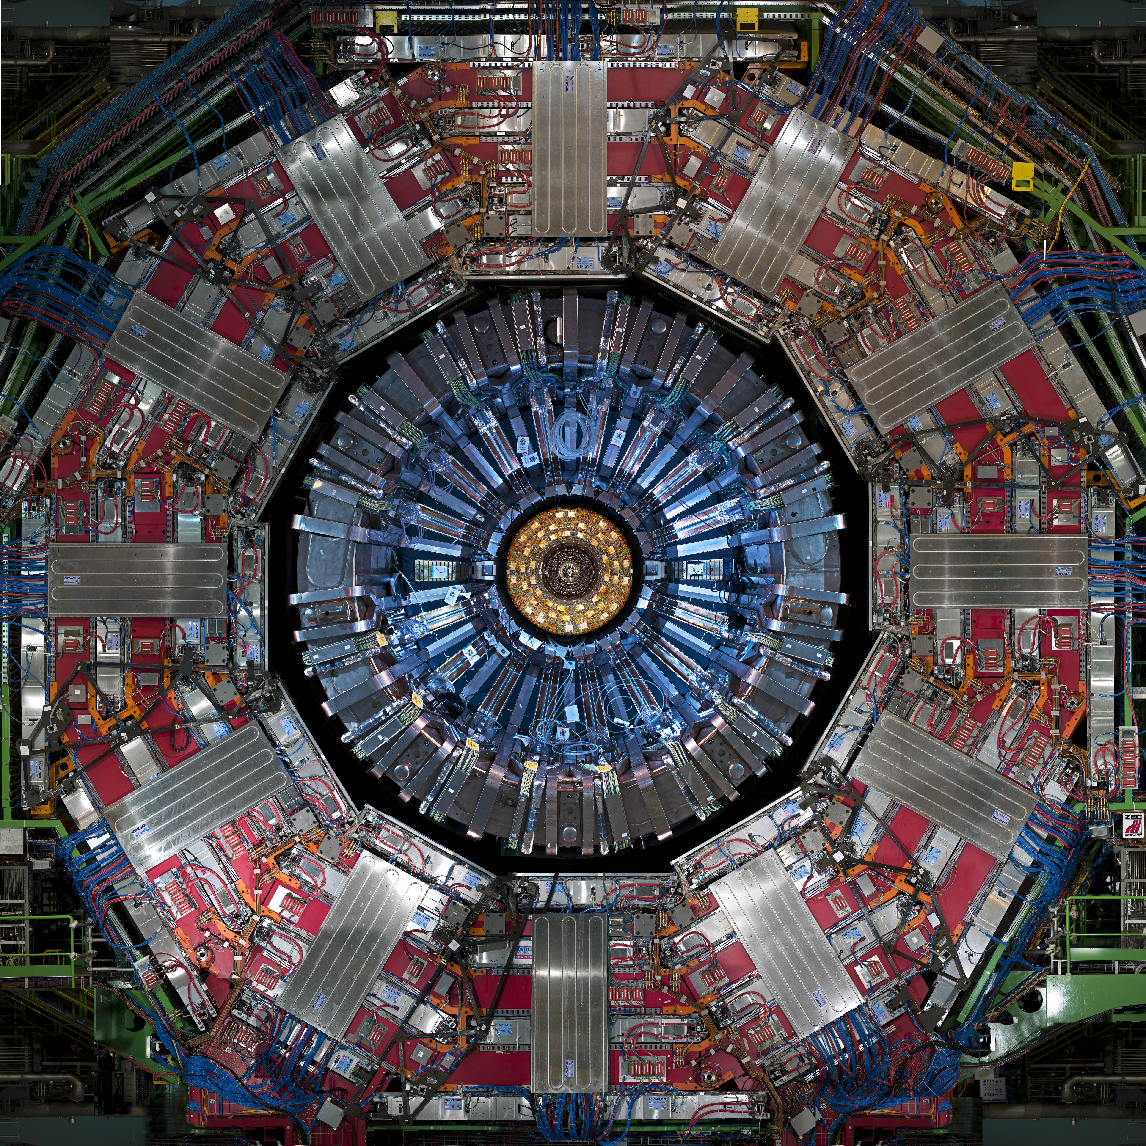

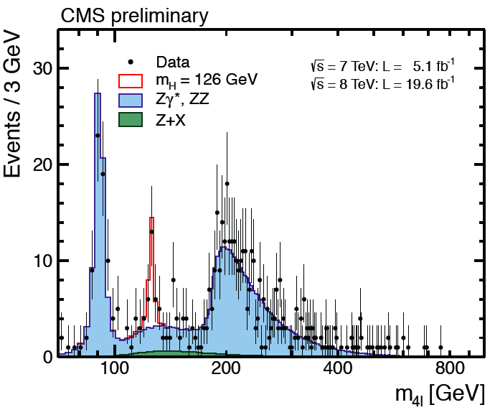
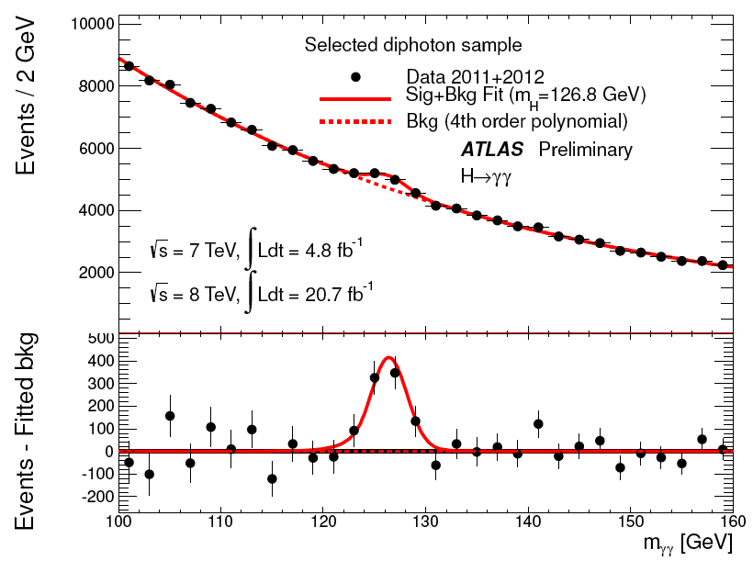

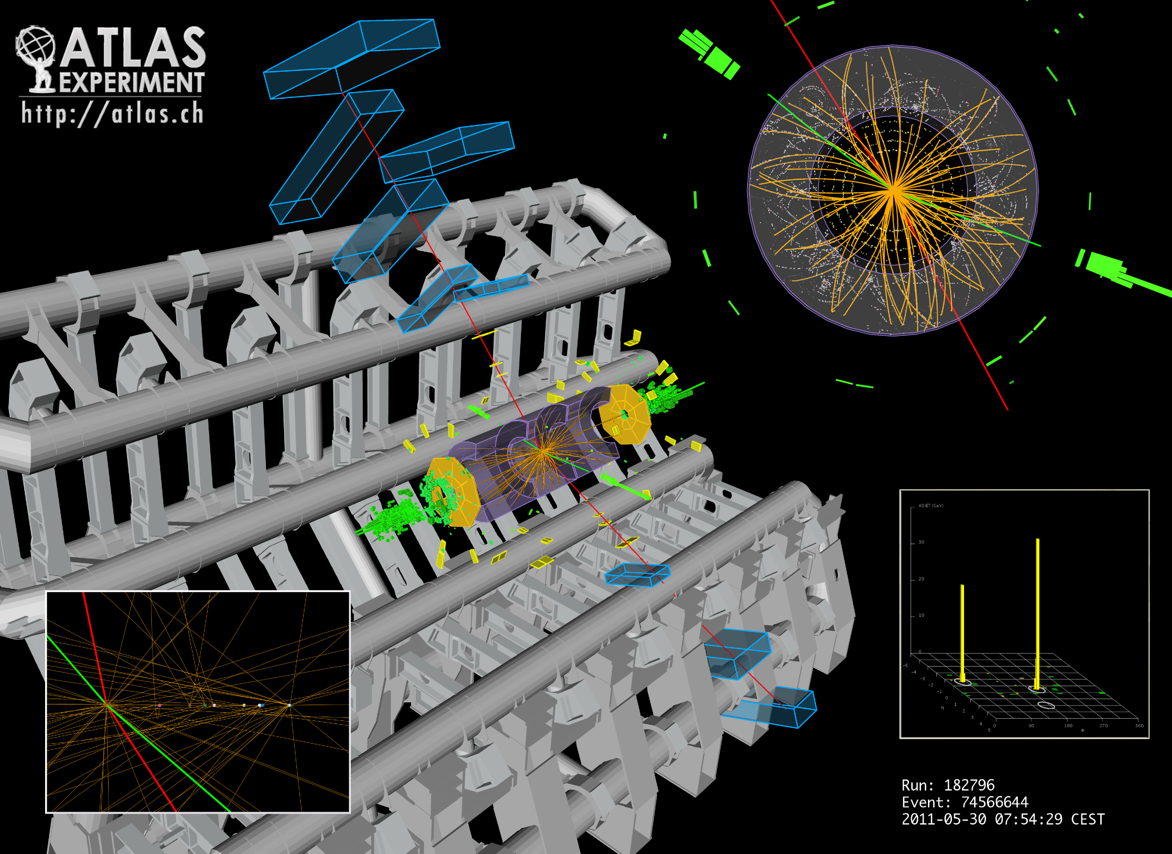
The Quest for the Higgs boson at the LHC
Highlights and Future Perspectives
Nature at the Energy Frontier
Latsis Symposium
ETH Zurich, 3rd June 2013
T. S.Virdee, Imperial College

Slide 2

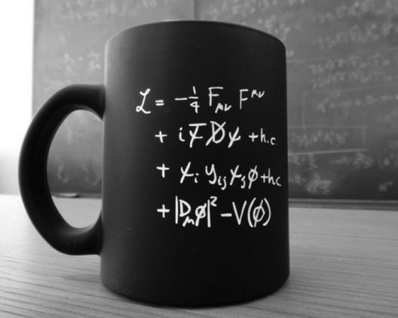
The Standard Model of Particle Physics
A crowning achievement of 20th Century Science
Matter particles
Force particles
The SM has been tested thousands of times, to excellent precision.
Its most basic mechanism, that of granting mass to particles, needed elucidation, => the Higgs boson?
Notes:
1st line Gauge fileds – gauge bosons
2nd line – kinetic terms of fermions
3rd line – coupling terms – couple gauge fields to the fermions
4th line – the scalar field and Higgs boson terms

Slide 3
Physics Outlook: Questions
1. SM contains too many apparently arbitrary features - presumably these should become clearer as we make progress towards a unified theory.
2. Clarify the e-w symmetry breaking sector
SM has an unproven element: the generation of mass
Higgs mechanism ->? or other physics ?
Answer will be found at LHC energies
e.g. why M_{γ} = 0
M_{W}, M_{Z} ~ 100,000 MeV!
Transparency from the early 90’s
3. SM gives nonsense at LHC energies
Probability of some processes becomes greater than 1 !! Nature’s slap on the wrist!
Higgs mechanism provides a possible solution
4. Identify particles that make up Dark Matter
Even if the Higgs exists all is not well with SM alone: next question is “why is (Higgs) mass so low”?  
If a new symmetry (Supersymmetry) is the answer, it must show up at O(1TeV)
5. Search for new physics at the TeV scale
SM is logically incomplete – does not incorporate gravity
Superstring theory adramatic concepts: supersymmetry , extra space-time dimensions ?
Notes:
The main problems of the SM show up in the Higgs sector.

Slide 4

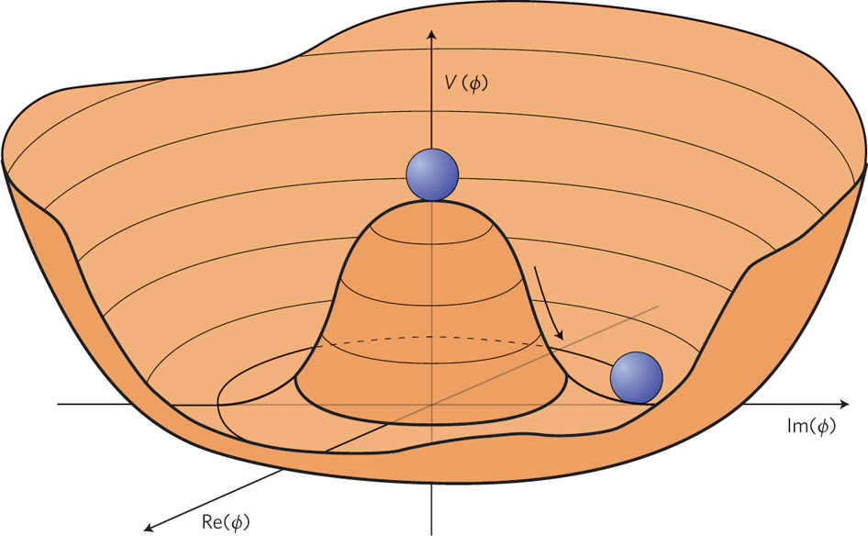
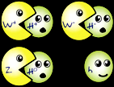
Spontaneous Symmetry Breaking
Unbroken Gauge Theory a
Massless Gauge Bosons
EW Theory a
Massive W±, Z
Massless γ l
SSB
Notes:
The freedom to alter the phase of a single particle’s wavefunction locally is only possible if some kind of force field is introduced.
This requirement of local phase invariance has played a very important role in building the SM
It’s application to the wavefunction of a charged particle leads to electromagnetic interaction through a massless gauge boson (the photon).
In weak interaction, with a massive mediator gauge boson, we need to introduce a different type of potential, with two minima (in 2D). The laws are left-right symmetric but not the equilibrium state.
The left-right symmetry is spontaneously broken.
A complex scalar doublet is introduced, and 3 of the real field are eaten up by the IVB to give them mass and a fourth leftover becomes the Higgs boson.

Slide 5
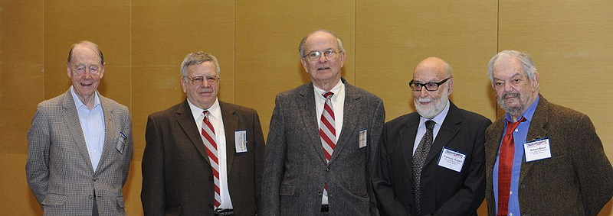
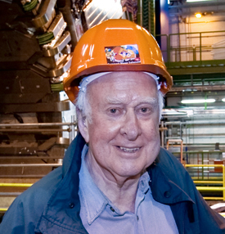
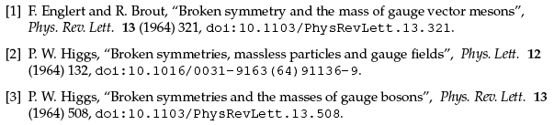

Almost 50 years ago – the seminal papers
Kibble
Guralnik
Hagen
Englert
Brout
Higgs
An Intellectual Conjecture: The 1st references in ATLAS/CMS Discovery papers
These papers on the spontaneous symmetry breaking mechanism attracted very little attention at the time. The boson attracted even less interest (T. Kibble, 2011)

Slide 6
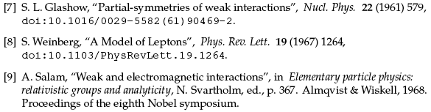
Almost 50 years ago – the seminal papers
References in ATLAS/CMS Discovery papers
Further work on the detailed application of the SSB mechanism to non-abelian theories. This work helped in getting to electroweak unification.
Describes the real world: photon massless, W/Z massive”
F. Close, “Infinity Puzzle”
SU(2)XU(1): Unified model of weak and electromagnetic interactions of leptons proposed by Weinberg (1967), and independently by Salam (1968). Labeled electroweak theory by Salam

Slide 7
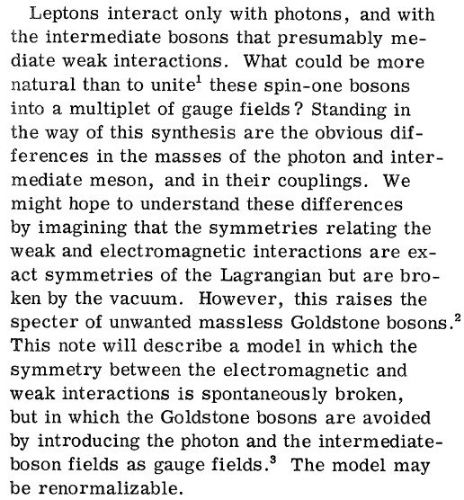
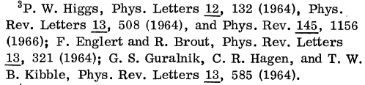
Electro-weak Unification: seminal papers
A Model of leptons (S. Weinberg, 1967)

Slide 8
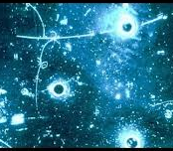
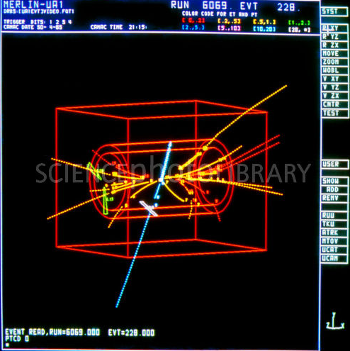
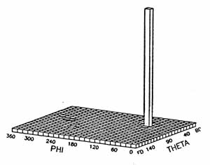
Further Theoretical and Experimental Developments
Salam and Weinberg speculated that their theory was renormalizable
This was proven in 1971 (by Gerard ’t Hooft & Tini Veltman)
In 1973 a key prediction of the e-w theory, the existence of neutral current interactions — those mediated by Z⁰ — was confirmed at CERN.
In 1983 the W and Z particles were discovered at CERN (UA1 and UA2)
then the Higgs boson became the last important missing piece of SM!
Notes:
The first example of the neutral-current process ν_{μ}bar + e⁻ -> ν_{μ}bar + e⁻. The electron is projected forward with an energy of 400 MeV at an angle of 1.5 ± 1.5° to the beam, entering from the right.

Slide 9
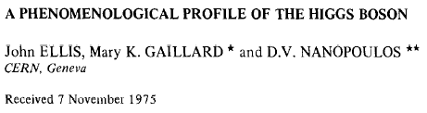
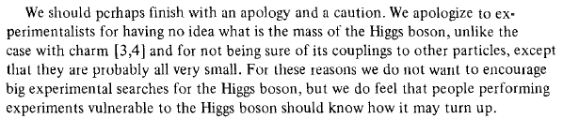
A Phenomenological Profile of the Higgs Boson
Reviewed Higgs decay modes and status of the searches in 1975

Slide 10
Timeline of the LHC Project
Workshop on a Large Hadron Collider in the LEP tunnel, Lausanne
Rubbia “Long-Range Planning Committee” recommends
Large Hadron Collider as the right choice for CERN’s future
ECFA LHC Workshop, Aachen
1992 General Meeting on LHC Physics and Detectors, Evian les Bains
1993 Letters of Intent (ATLAS and CMS selected by LHCC)
Technical Proposals Approved
1997 Approval to move to Construction (materials cost of 475 MCHF)
Memorandum of Understanding for Construction Signed
1998 Construction Begins (after approval of Technical Design Reports)
2000 ATLAS and CMS assembly begins above ground. LEP closes
2008 ATLAS & CMS ready for First LHC Beams
2009 First proton-proton collisions
2012 A new heavy boson discovered with mass ~125 × mass of proton

Slide 11
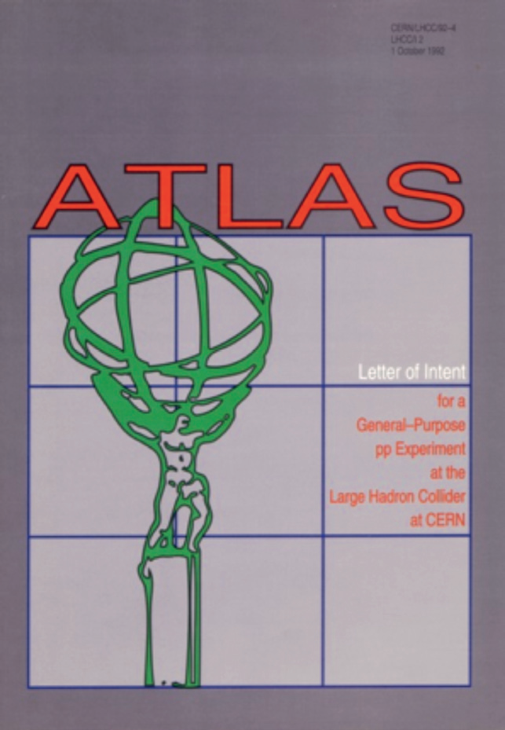
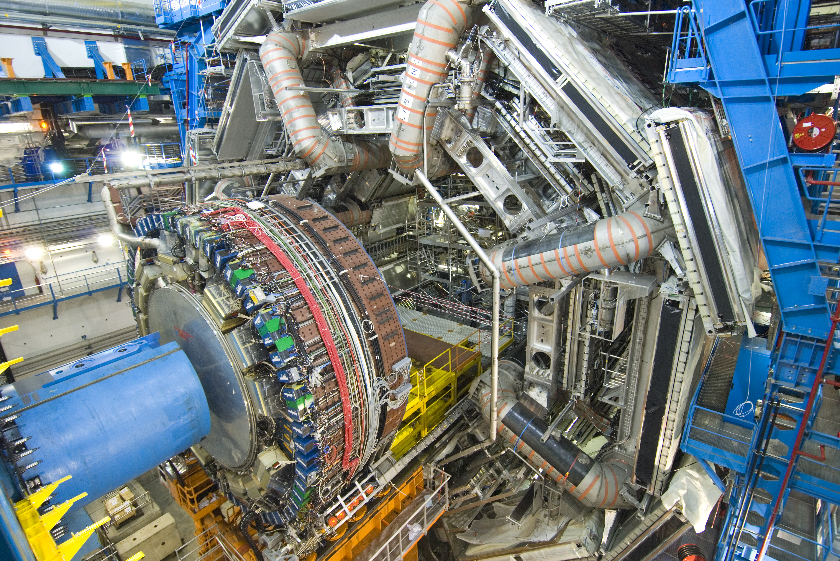
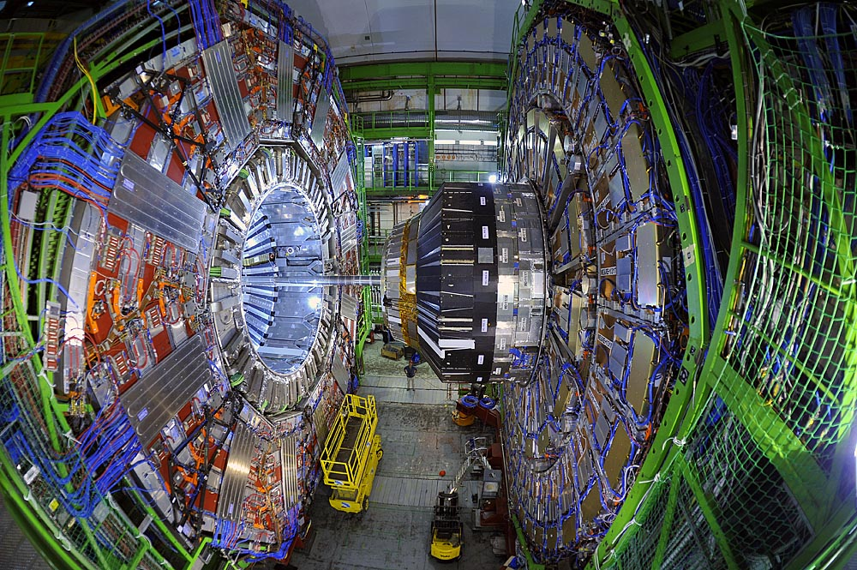
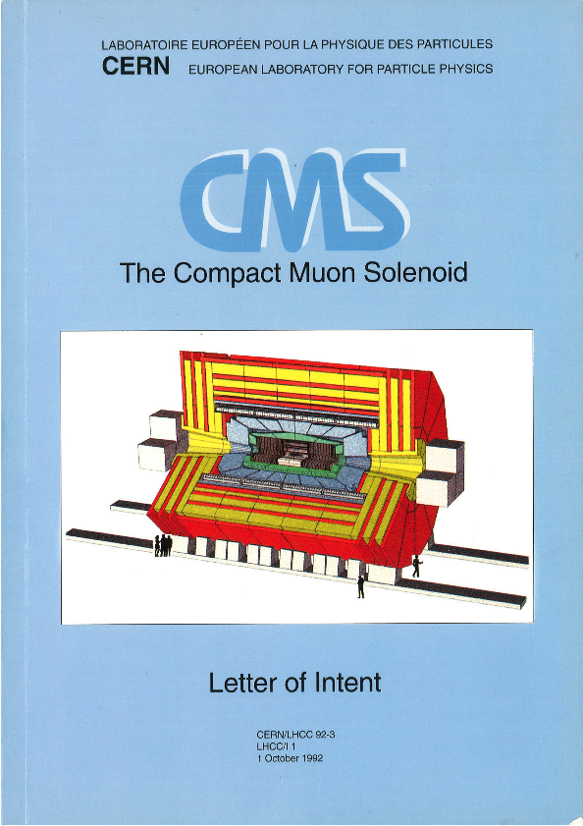
20 Years Ago: Approval of ATLAS and CMS LoI
LHCC
June 1993
15 Years
Later

Slide 12
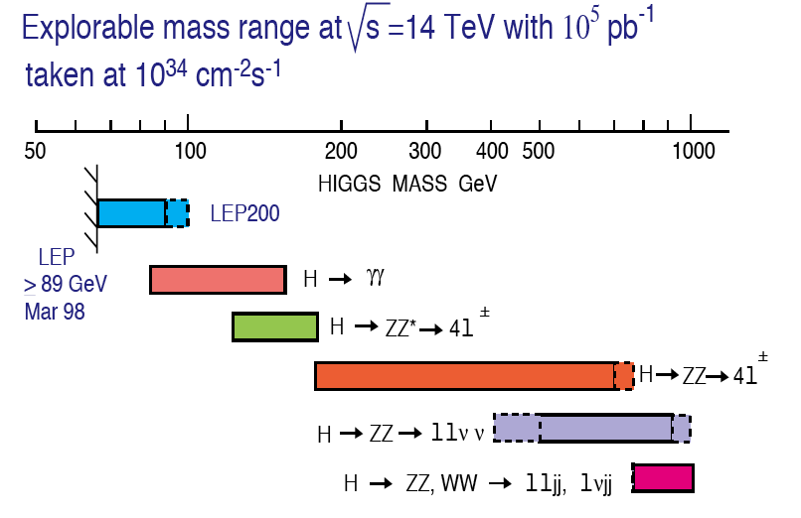
SM Higgs Boson as a Physics Benchmark For Detector Design
Natural Width 0.01 1 10 100 GeV
Theory does not predict m_{H}
The favourable decay modes change with mass
Transparency
from the 90’s
Notes:
Comment on the width – narrow at low masses – stringent design constraint for ECAL and muon/tracking
In the early days no mention of the possibility of WW, bb, tautau ! – were considered too difficult to extract!
Even ZZ was not considered below 130 GeV
That we have been able to do so is due to the power of the ATLAS and CMS detectors.

Slide 13
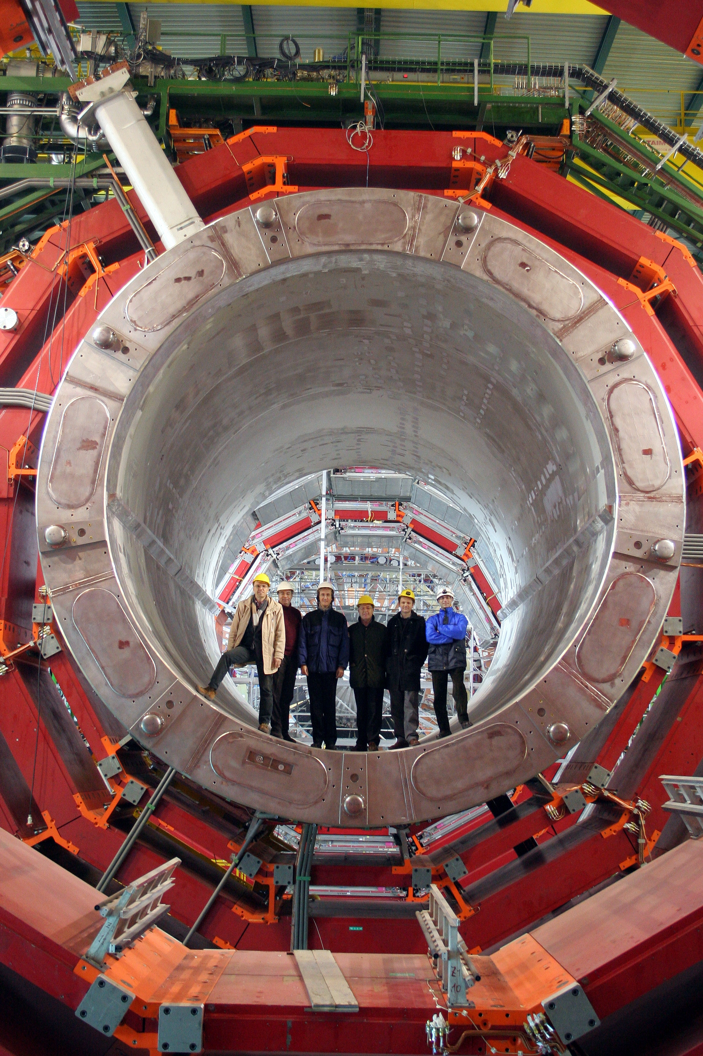
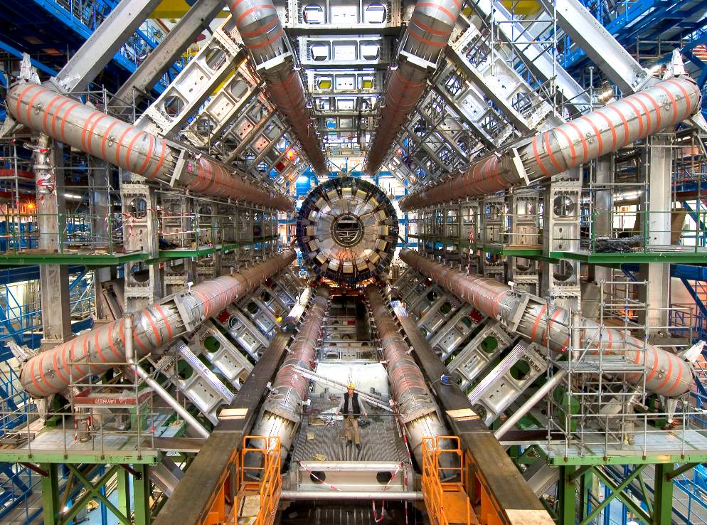
Designs of LHC-GPDs
Designs determined by the choice of magnet field configuration for the measurement of muons
ATLAS Superconducting Air-core Toroid
CMS Superconducting Solenoid

Slide 14
CMS Concept to Data Taking – took 18 Years!

Slide 15
Construction of the ATLAS Detector

Slide 16
An Example from the Construction of ATLAS and CMS
The Electromagnetic Calorimeters
Physics Drove the Design
Measure the energies of photons from
a decay of the Higgs boson
to a precision of ~ 0.5%
and mass to a precision of < 1%.

Slide 17
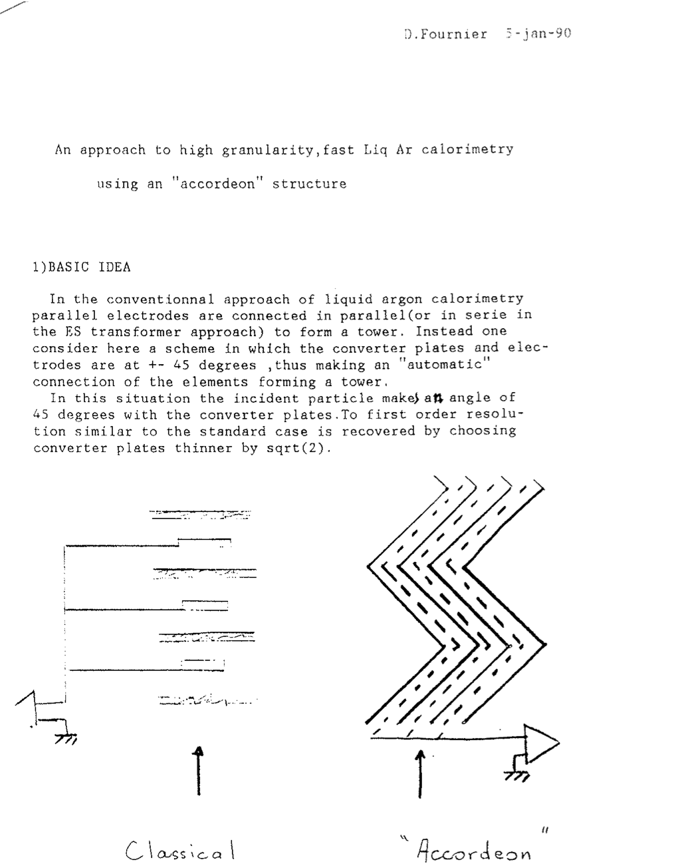
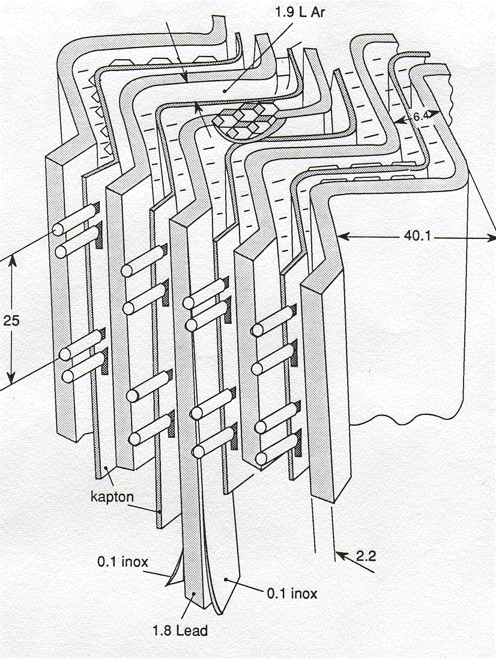
ATLAS Electromagnetic Calorimeter
From Concept to the Liquid Argon Calorimeter
a very stable and radiation hard detector
easy to calibrate
a lot of freedom in spatial granularity
difficult to construct… cryogenics

Slide 18
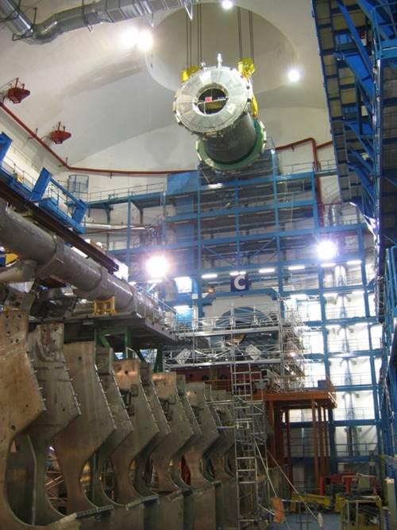
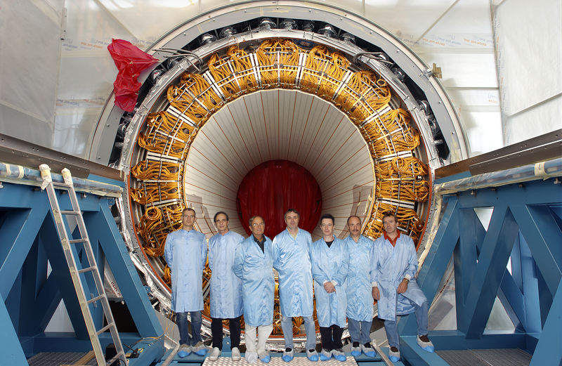
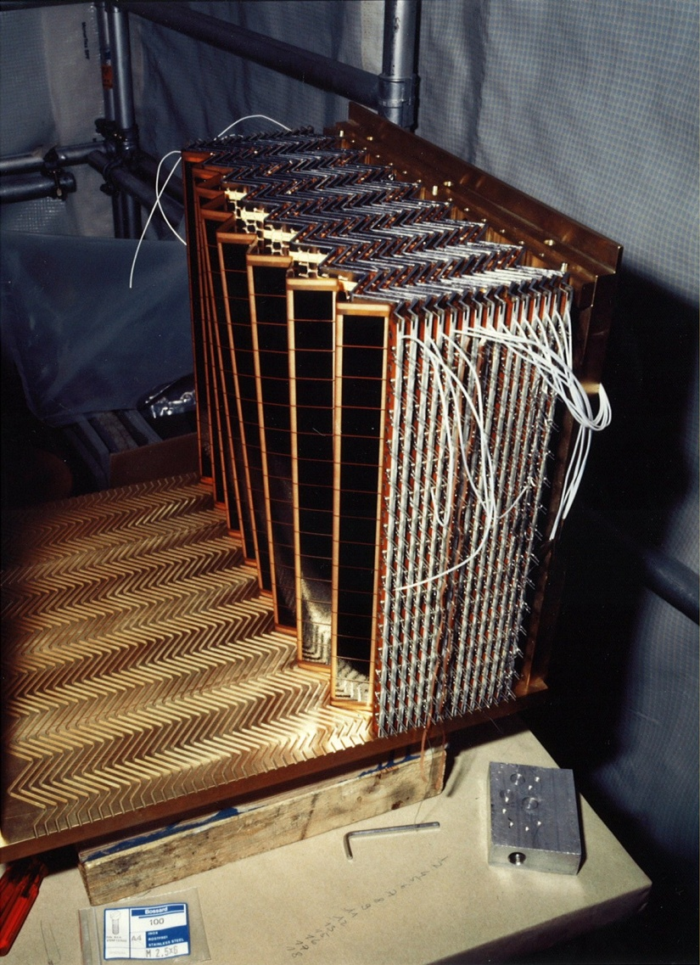
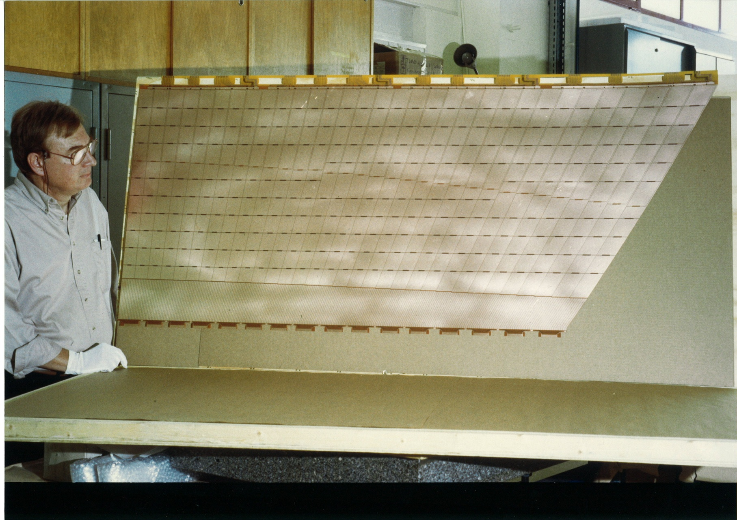
ATLAS Electromagnetic Calorimeter
From Concept to the Liquid Argon Calorimeter
First prototype 1990
Construction 1998
Installation 2004

Slide 19
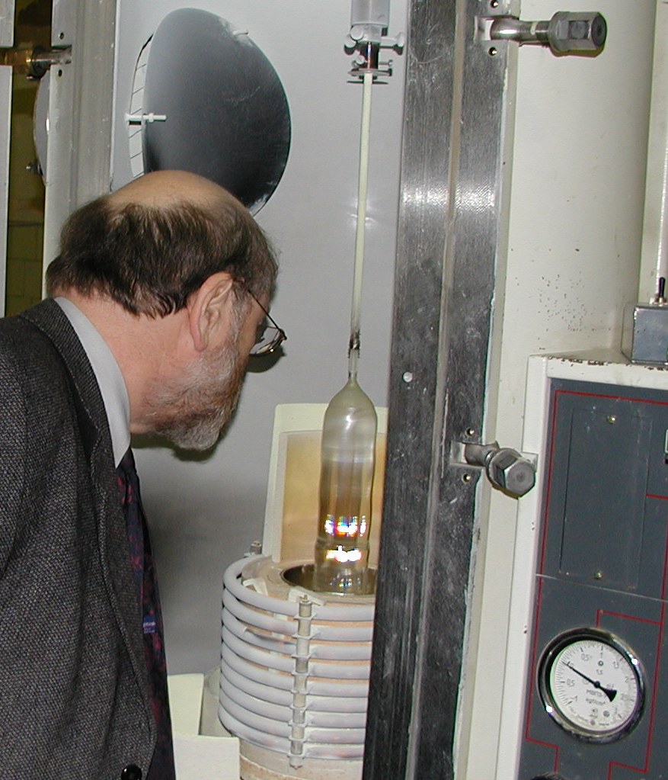
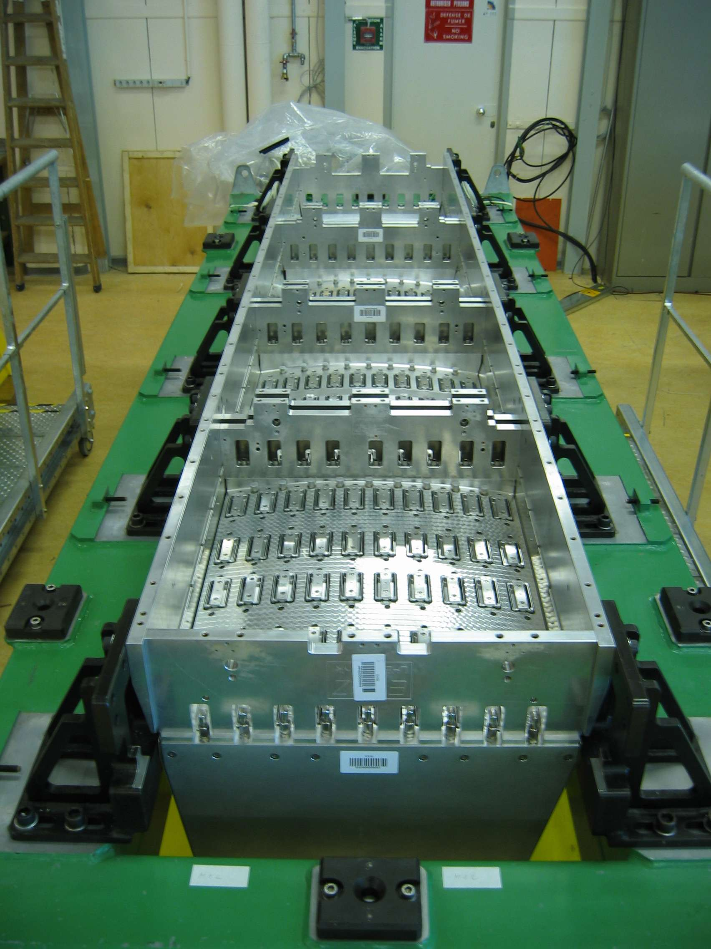
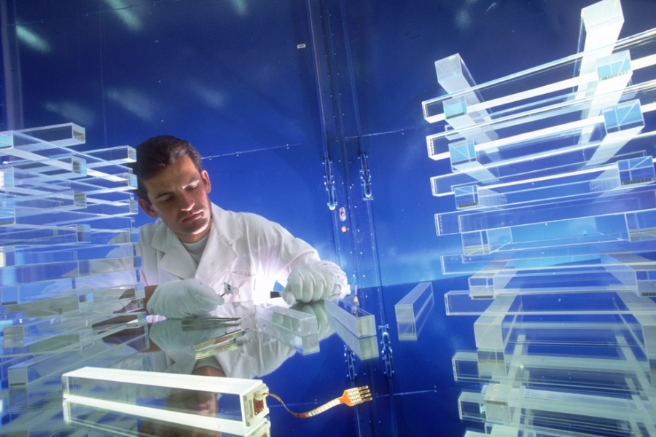
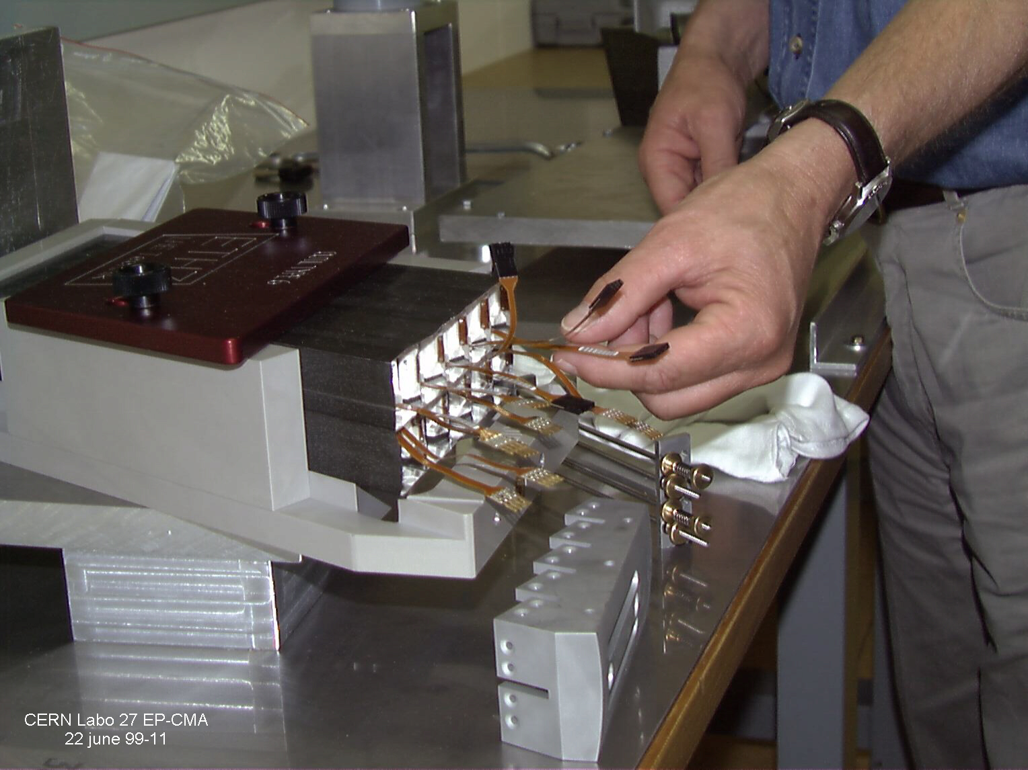
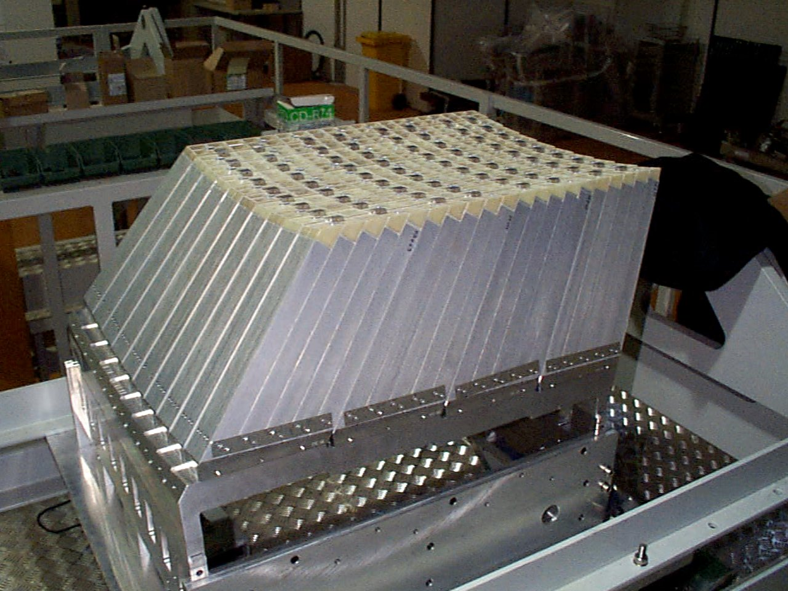
CMS Electromagnetic Calorimeter:
Lead Tungstate Scintillating Crystals
Submodule
2x5 crystals
Module
400 crystals
Supermodule
1700 crystals
Total 36 Supermodules

Slide 20
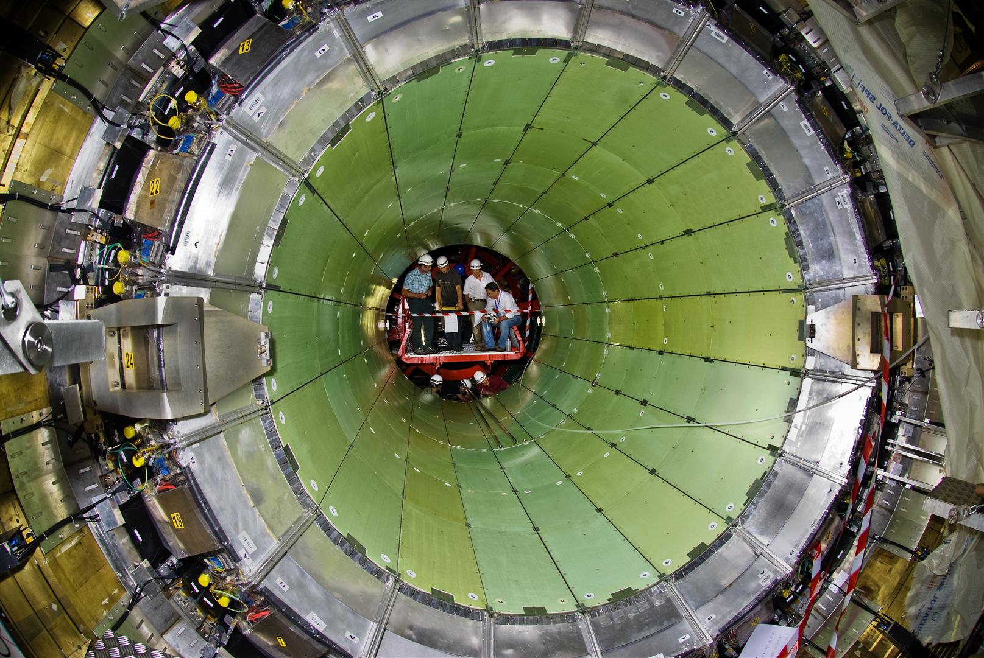
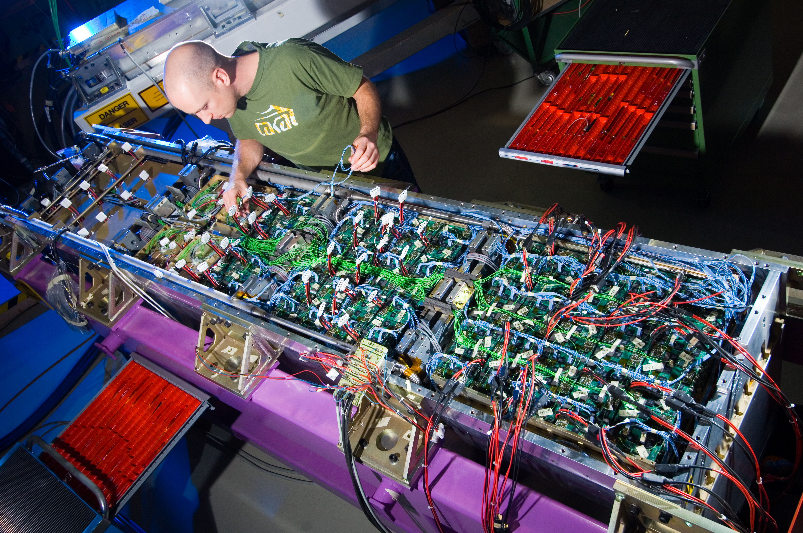

CMS Electromagnetic Calorimeter:
15 years from Concept - Installation
Jul 2007

Slide 21
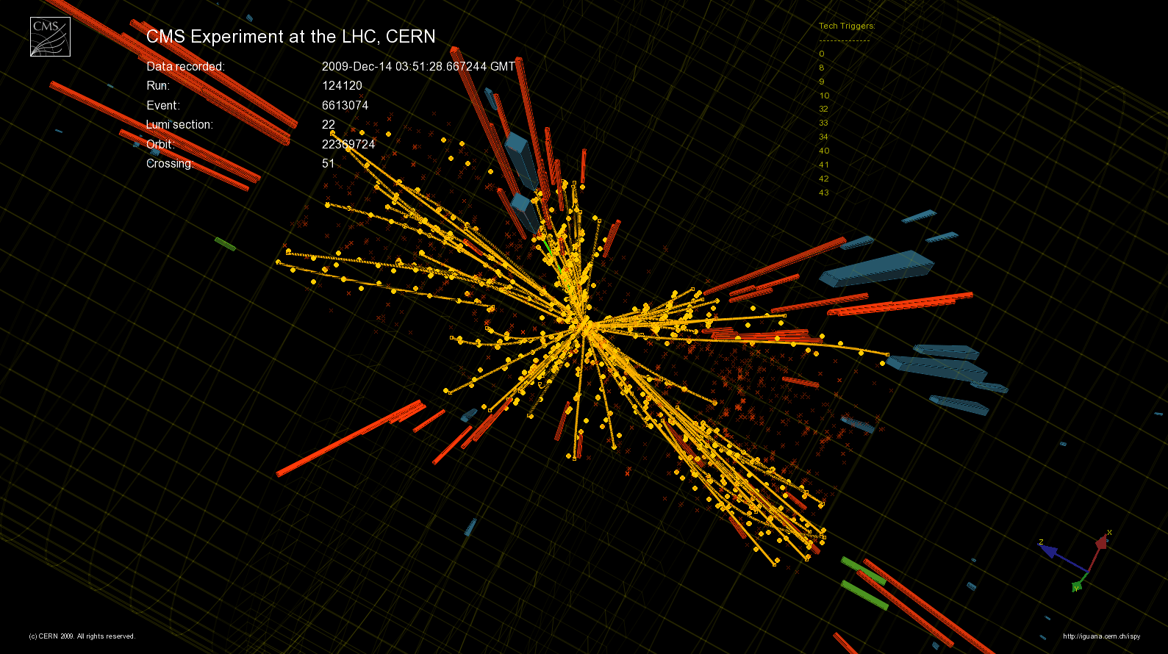
A proton-proton Collision at the LHC

Slide 22
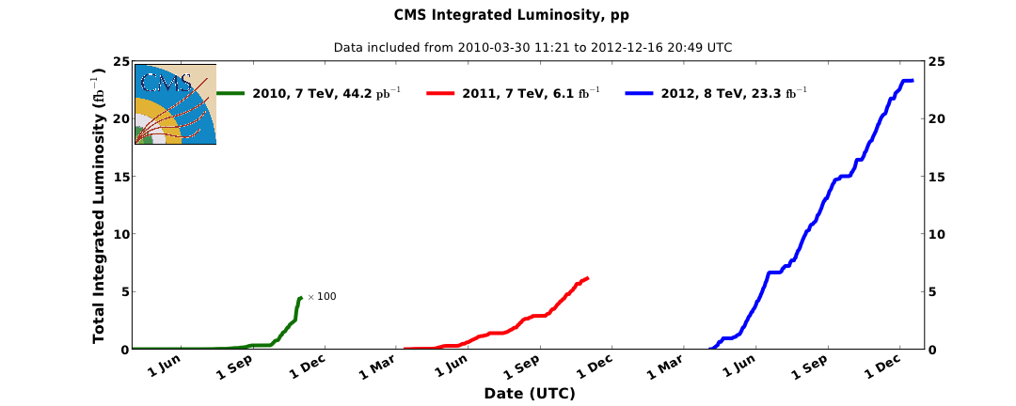
Run 1: The LHC has performed marvelously well!
2010: 44 pb⁻¹
2011: 6 fb⁻¹
2012: 23 fb⁻¹
Discovery of
a new boson
1fb⁻¹ equivalent to study of 80 trillion pp interactions

Slide 23
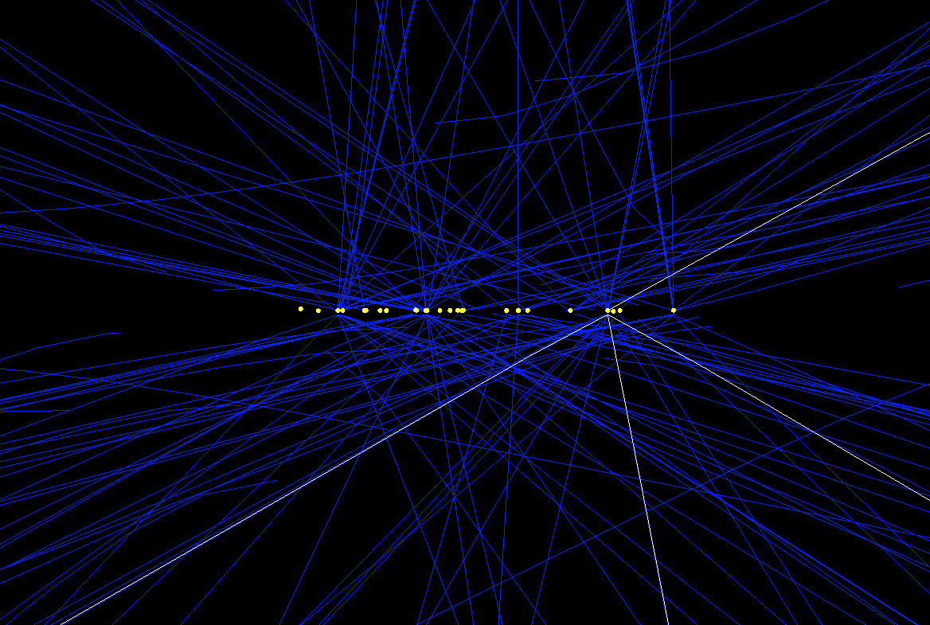
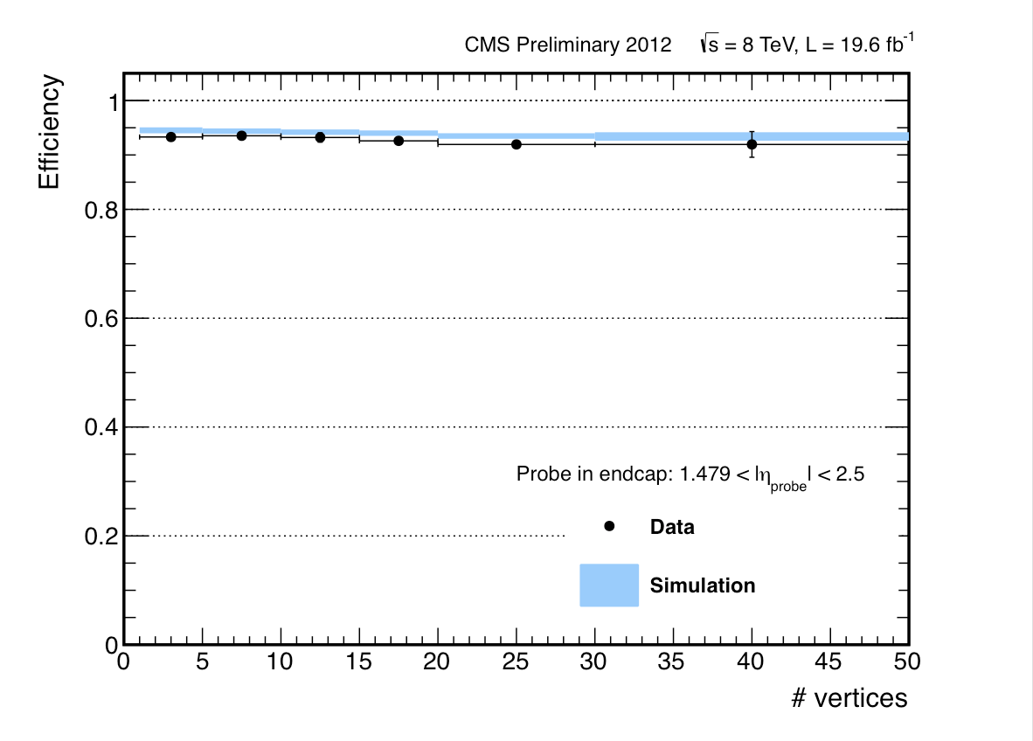
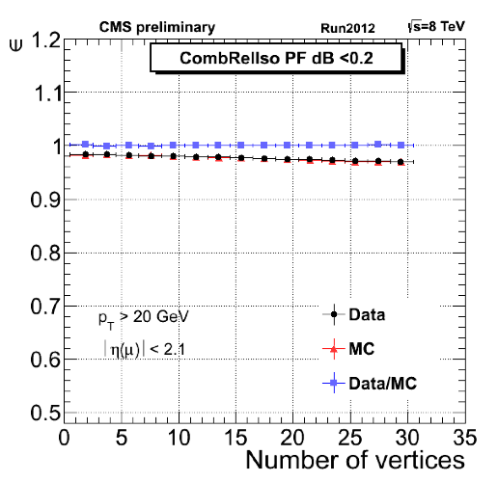
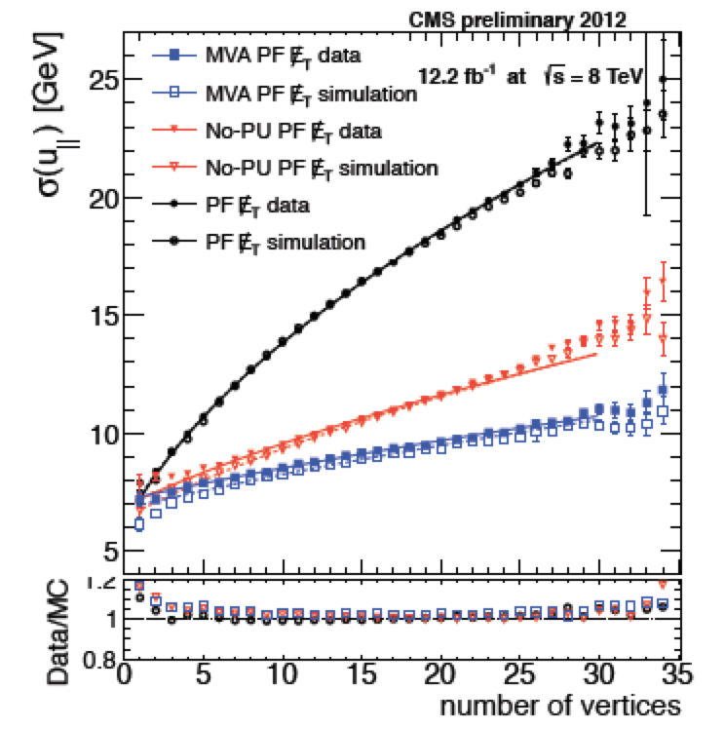
Performance under Pileup
Muon ID
electrons
MVA ID + isolation efficiency
(Endcaps)
# vertices
H→ ZZ →4l candidate
24 vertices
MET resolution
Muon isolation
Leptons and MET
Almost insensitive
to pileup
Notes:
DO WE HAVE SOMETHING FOR THE PHOTONS?
PUT IT ON HGG SLIDE?

Slide 24
Going to the Science
1. Do the experiments perform as designed?
2. Is known physics correctly observed?
3. Then look for new physics
We can only claim signals of new physics after having
made measurements of already known physics that are
consistent with the precise predictions
of the Standard Model.

Slide 25
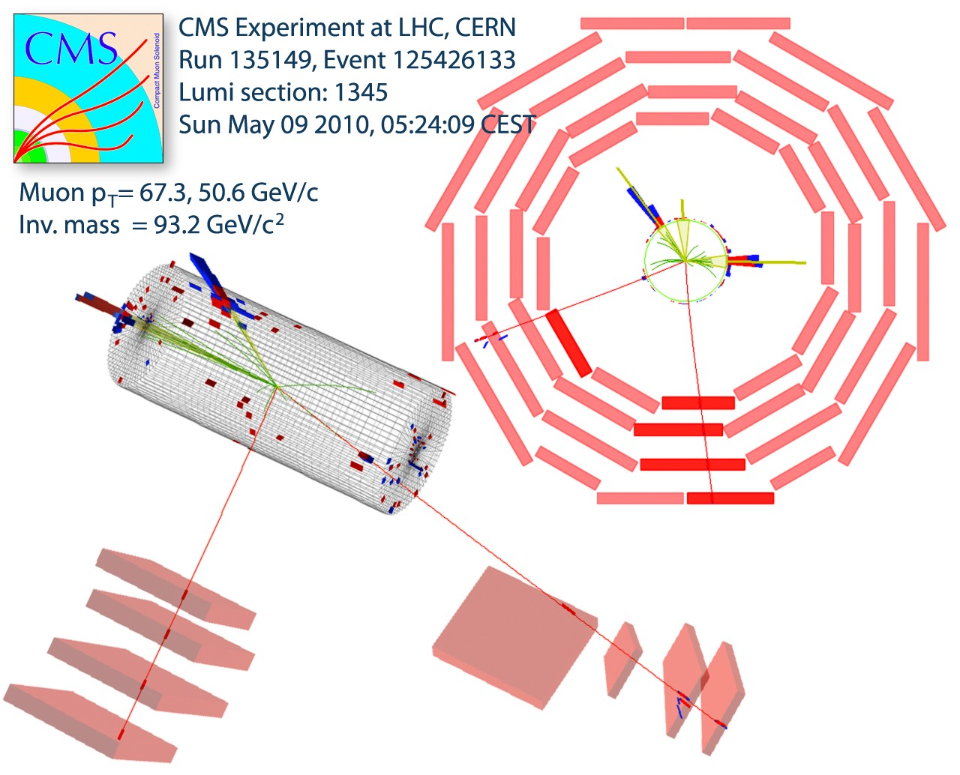
1. A Z boson decaying into μ⁺ μ⁻ pair

Slide 26
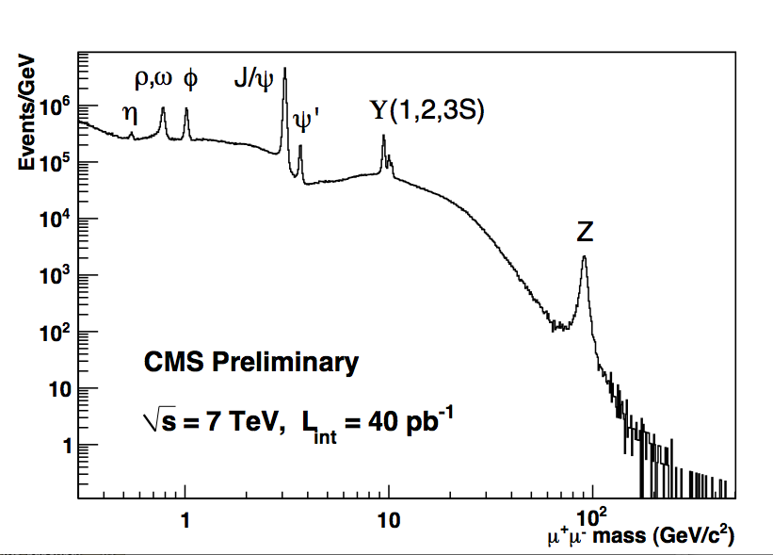
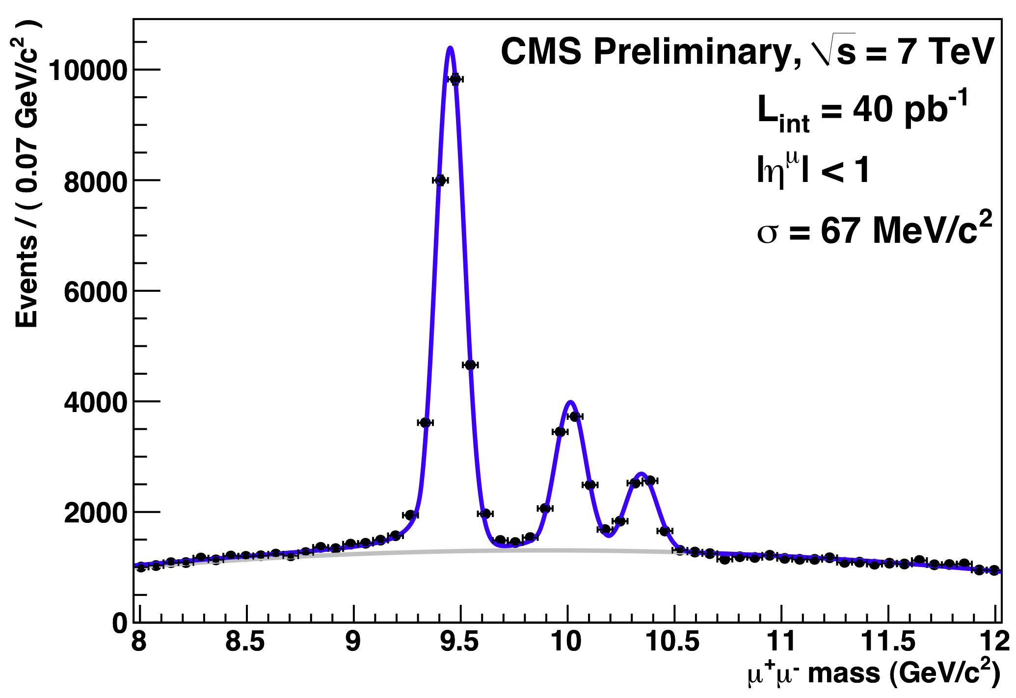
1. Performance of Experiment: e.g. CMS
Di-muons
2010
Notes:
This figure shows the distribution of effective masses calculated using the four-momenta of all dimuon pairs detected in CMS upon examination of some 3 trillion proton-proton interactions. The sharpness of the peaks, corresponding to the labeled particle states, depends on the natural width of the state under study, defined as h/(2 πι ξ ταυ), where tau is the lifetime of the particle, and/or on the experimentally achievable mass resolution. For example, the observed width of particles such as J/ypsior Upsilon is dominated by the instrumental resolution whilst that of the Z by its natural width. The background can also be seen and the clarity (high signal over background) of the signals is evident. It is remarkable that the ATLAS and CMS experiments, arguably the most technologically challenging scientific instruments ever built, achieved their design mass resolutions after the first few months of data-taking.

Slide 27
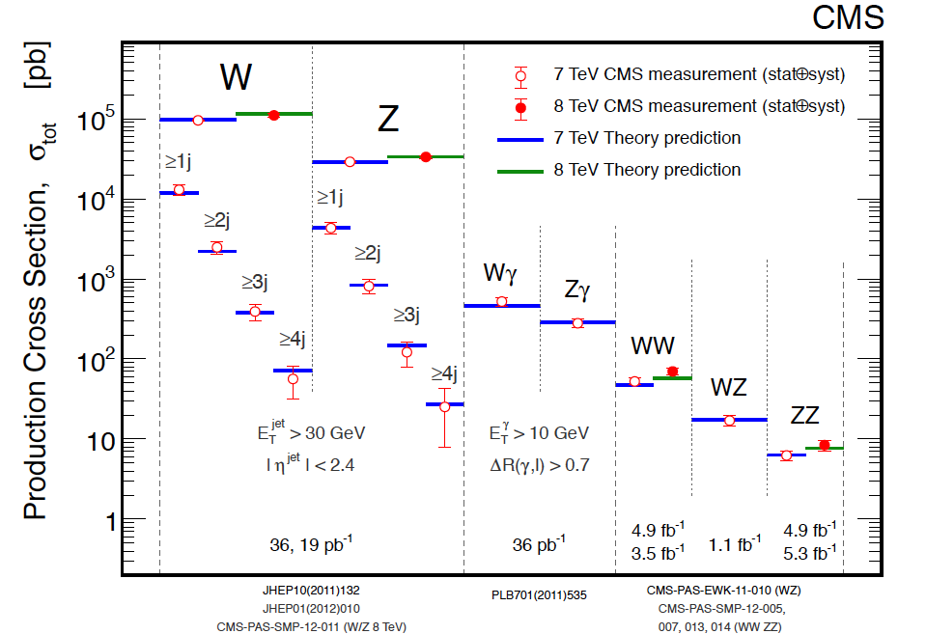
2. SM Electroweak Measurements
1 in 10 million pp interactions produces a W → e ν

Slide 28

Known physics is measured as predicted
Searches beyond known physics
1. Search for the Higgs boson
2. Search for physics beyond the SM
Supersymmetry
Extra Dimensions
Unexpected physics?

Slide 29
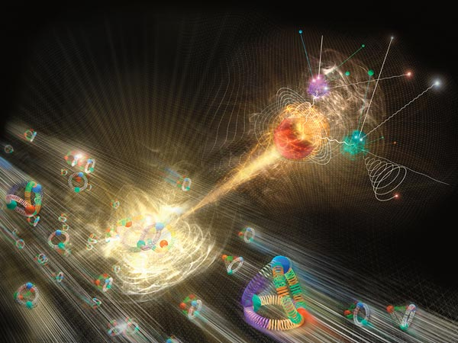
Seeking the Higgs Boson
National Geographic

Slide 30
Search for the SM Higgs Boson
Higgs lifetime (125 GeV): 10^{–22} s
Will only see decay products
Higgs couples to mass:
Coupling to fermions ~ (M_{f}/v)²
Suitable at LHC
Coupling to bosons ~ (M_{V}/v)⁴
Suitable at LHC:
Special Case:

Slide 31
Search for the SM Higgs Boson
For a given Higgs boson mass hypothesis, the sensitivity of the search depends on:
the mass of the Higgs boson
Higgs boson production cross section,
the decay branching fraction into the chosen final state,
the signal selection efficiency,
the Higgs boson mass resolution, and
the level of backgrounds with the same or a similar final state.

Slide 32
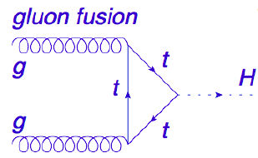




SM Higgs Boson: Production Cross-section
Main production via a quantum loop!
Integrated Luminosity
~5 fb⁻¹ at √s=7TeV and ~ 20fb⁻¹ at √s=8TeV
2000 trillion pp collisions examined
And potentially produced
~ 700k SM Higgs bosons (m_{H}=125 GeV)

Slide 33

SM Higgs Boson: Decay Modes
Natural Width: Γ_{H_125} ~ few MeV
The best instrumental mass resolution achievable is ~1GeV
Only two channels have such a resolution
with decay Branching Fractions:
decay branching fraction
γγ is 2 per mille
ZZ → 4l is ~10⁻⁴
m_{H}= 125 Exp Sig σ_{M}/M
bb 2.2σ 10%
ττ 2.6σ 10%
WW 5.3σ 20%
ZZ 7.1σ 1-2%
γγ 3.9σ 1-2%
At m_{H} ~125 GeV many decay modes are detectable
Makes it easier to establish whether it is a SM Higgs boson or not

Slide 34
H→ 2γ Channel
H ➔γγ
candidate
Expect
450 events
S/B ~ 3%

Slide 35





Search for the SM Higgs boson in the γγ channel
Signal:
H
H
Background: essentially from QCD processes
Irreducible: QCD processes
Reducible: Compton (gq→γq, q(jet)→γ)

Slide 36

Preliminary Results from the Full Dataset
ATLAS: H→ 2γ Channel
CMS: H→ 2γ Channel
Sign/Exp | Exp | Obs
ATLAS | 4.1 σ | 7.1 σ
CMS | 4.2 σ | 3.2 σ

Slide 37
H→ ZZ⁽*⁾ → 2μ2e Channel
H ➔2μ2e
candidate
Expect
20 events
S/B ~ 1.5

Slide 38

Preliminary Results from the Full Dataset
ATLAS: H→ 4l Channel
CMS: H→ 4l Channel
Significance | Exp | Obs
ATLAS | 4.4 σ | 6.6 σ
CMS | 6.7 σ | 7.2 σ
Notes:
CMS data >160 GeV observe 380 expect 365.

Slide 39

H → WW → 2l2ν channel
Signature:
2 high pT leptons
large missing ET
Expect
200 events
S/B ~ 15%
qq→WW + gg→WW
Non-resonant
H→WW
Large BR
Small Δφ(ll)
Main backgrounds:
WW, top
Other backgrounds:
W+jet, Z/γ*, WZ, ZZ, Wγ

Slide 40


Preliminary Results from the Full Dataset
ATLAS: H→ WW→2l 2ν Channel
Full Dataset
CMS: H→ WW→2l 2ν Channel
Full Dataset
Sign/Exp | Exp | Obs
ATLAS_{full} | 3.7 σ | 3.8 σ
CMS_{full} | 5.1 σ | 4.0 σ
at 125 GeV
Notes:
In the H -> WW(*) -> 2l2n channel, we search for an excess of events with two leptons of opposite charge, large EmissT , and up to two jets. Events are divided into six categories,
with different background compositions and signal-to-background ratios. For events with no jets, the main background stems from non-resonant WW production; for events with one jet, the dominant backgrounds are from WW and top-quark production. The events are split into same-flavour and different-flavour dilepton sub-channels, since the background from Drell– Yan production (qq-> g/Z(*) -> ll) is much larger for the same-flavour dilepton events. The two-jet category is optimised to take advantage of the VBF Higgs boson production signature. The main background in this channel is from top-quark production. The 2D distribution of events in the (mll,mT) plane is used for different-flavour dilepton channels with zero and one jet; mll is the invariant mass of the dilepton pair, and mT is the transverse mass reconstructed from the transverse momentum of the dilepton pair and the vector ~EmissT . All background rates, except for very small contributions from WZ, ZZ, andWg, are evaluated from data.

Slide 41



W/Z + H, H→ττ
CMS Preliminary results from Full Dataset
eτ_{h}, mτ_{h}, eμ, τ_{h}τ_{h}
Signif. | Exp | Obs
CMS | 2.6 σ | 2.9 σ
It decays to taus (and thus to fermions)
at 125 GeV
Notes:
The H->tautau search [68] is performed using the final-state signatures em, mm, eth, mth, thth, where electrons and muons arise from leptonic t-decays and tauh denotes a t lepton decaying hadronically. Each of these categories is further divided into two exclusive sub-categories based on the number and the type of the jets in the event: (i) events with one forward and one backward jet, consistent with the VBF topology, (ii) events with at least one high pT hadronic jet but not selected in the previous category. The second category is further split in two bins of reconstructed t lepton pT. In each of these categories, we search for a broad excess in the reconstructed tt mass distribution. The zero-jet category is used to constrain background normalisations, identification efficiencies, and energy scales. The main irreducible background, Z ! tt production, and the largest reducible backgrounds (W + jets, multijet production, Z ! ee) are evaluated from various control samples in data.

Slide 42


Search for SM VH (H → 2b): CMS Full Dataset
Significance | Exp | Obs
CMS | 21 σ | 2.1 σ
σ/σ_{SM} = 1.0±0.5
at 125 GeV

Slide 43



Search for SM VH (H → bb) (Tevatron)
-
Sign/Exp | Exp | Obs
Tevatron | 2.1 σ | 3.0 σ
at 125 GeV
σ/σ_{SM} = 1.4± 0.6

Slide 44

Putting It All Together

Slide 45


Mass
CMS
ATLAS
125.7 ± 0.3 (stat) ± 0.3 (syst) GeV
125.5 ^{+0.5} _{-0.6} (stat) ± 0.2 (syst) GeV
M_{t} (Tevatron) = 173.18 ± 0.94 GeV
M_{t} (LHC) = 173.36 ± 1.10 GeV
Notes:
To extract the value of mX in a model-independent way, the signal strength modifiers for the gg -> H -> gg, VBF+VH-> gg, and H -> ZZ -> 4l processes are assumed to be independent and, thus, not tied to the SM expectation. The signal in all channels is assumed to be due to a state with a unique mass, mX.

Slide 46



Couplings
Signal strength and comparison to SM Higgs boson: μ = σ/σ_{SM}
CMS : 0.80 ± 0.14
ATLAS: 1.30 ± 0.20
Tevatron
1.40 ± 0.60
Notes:
The symbol sigma/sigma_SM denotes the production cross section times the relevant branching fractions, relative to the SM expectation.

Slide 47



Do Couplings Scale as Expected in the SM?
σ.BR/(σ.BR)_{SM}
is consistent with 1
Higgs couplings are proportional to masses
Notes:
Lambda = mH**2/2v**2
Yukawa
Nearly impossible to produce by accident!

Slide 48




Do Couplings Scale as Expected in the SM?
b
τ
t
V
g
γ

Slide 49
Spin
Prediction for SM Higgs boson is J^{P} = 0⁺
It decays into two photons so not spin-1 (Landau-Yang theorem)
Use angular distributions of the decay products in H rest frame
Construct BDT variables out of distinguishing information
H→γγ ,H →ZZ and H→WW
H→ZZ used to test 0⁻ and 1⁺ scenarios
Spin 2⁺ hypothesis tested in all channels*
*Graviton inspired model - production mechanism is unknown so present results as fraction of qq to gg
Notes:
To extract the value of mX in a model-independent way, the signal strength modifiers for the gg -> H -> gg, VBF+VH-> gg, and H -> ZZ -> 4l processes are assumed to be independent and, thus, not tied to the SM expectation. The signal in all channels is assumed to be due to a state with a unique mass, mX.

Slide 50

ATLAS Summary: Spin
3 channels combined exclude 2⁺ at 99.9% CL independent of production mode
H→ZZ excludes 0⁻, 1⁺ and (1⁻) at >95% (94%) CL.
Notes:
4 input variables – mT, Dphii(ll), mll, pTll

Slide 51



Spin 0 or 2? ATLAS: H→ WW→2l 2ν
Combine several variables in a multivariate discriminant (BDT)
Variables used: m_{ll}, P_{T}^{ll}, Δφ_{ll}, m_{T}
Background subtracted BDT
Data compatible with 0⁺ hypothesis
2⁺ (graviton-like) scenario excluded at:
99% CL if qq, 95% if gg production
Notes:
4 input variables – mT, Dphii(ll), mll, pTll

Slide 52




CMS: H→ ZZ⁽*⁾ → 4l Kinematic Discriminant
Matrix Element Likelihood Analysis:
uses kinematic inputs for
signal to background discrimination
{m₁,m₂,θ₁,θ₂,θ*,Φ,Φ₁}
SIGNAL
BACKGROUND
Notes:
Detailed kinematic information can be exploited to provide further discrimination between signal and background (two dilepton masses and five decay angles)

Slide 53


CMS: H→ ZZ⁽*⁾ → 4l: Spin 0⁺ v/s 0⁻
CMS data consistent with scalar (0⁺)
0⁺ vs 0⁻
0⁻
0⁺
data
CL_{s}=0.16%

Slide 54

Influence of Undiscovered Heavy Charged Particles?
e.g. H → γγ
Dominant production
mechanism
SM decay to 2γ
Importance of H → γγ channel
A signal strength different from SM would indicate new physics
ATLAS: μ=1.65^{+0.34}_{-0.30} CMS: μ=0.78^{+0.28}_{-0.26}

Slide 55


Any other Higgs bosons?
σ x BR limit for an additional gluon-gluon fusion produced Higgs boson with SM-like width decaying to ZZ → 4l
H to ZZ → 4l
Exclude M_{H}<800 GeV (95% CL)

Slide 56
What makes a SM Higgs boson?
Does it have spin 0 or 2? What is its parity (SM H → 0⁺)
Data consistent with 0⁺, excluding 0⁻ at >95% CL
Is it elementary or composite? (SM H is elementary)
No significant deviations from Standard Model
Couples to particle masses in proportion to their masses (~M_{f}²/v², ~M_{V}⁴/v²) ?
Evidence that it does
Couples to massless photon (gluons) trhrough loops of virtual charged/coloured particles (t, W,…)?
γγ coupling > Standard Model? Average appears consistent with SM.
What are its self-couplings? HL–LHC (>2025)
Is it alone? No evidence for another one but still looking
CPAN Granada Nov12-tsv

Slide 57

Is there any room for new physics?
Notes:
We believe there must be new physics
Some real and some virtual reasons to believe in new physics
Real reasons: dark matter & ν masses
Virtual reasons: naturalness

Slide 58
Physics of the LHC: Questions from the 1990’s
1. SM contains too many apparently arbitrary features – presumably should become clearer as we make progress towards a unified theory.
2. Clarify the origin of mass (e-w symmetry breaking sector)
SM has an unproven element: the generation of mass
The SSB mechanism ? or other physics ?
✔Answer may have been found
e.g. why M_{γ} = 0
M_{W}, M_{Z} ~ 100,000 MeV!
3. SM gives nonsense at LHC energies
Probability of W_{L}W_{L} scattering becomes greater than 1 !! Nature’s slap on the wrist!
✔Answer may have been found. Next: measure WW scattering at √s>1 TeV.
4. Identify particles that make up Dark Matter
Even if the Higgs exists, all is not well with SM alone: next question is “why is its mass so low”? If a new symmetry (Supersymmetry) is the answer, it must show up at O(1TeV). Lightest of the species is a candidate for dark matter
5. Search for new physics at the TeV scale
SM is logically incomplete – does not incorporate gravity
Superstring theory a dramatic concepts: extra space-time dimensions, supersymmetry ?

Slide 59

Any other Higgs bosons? SUSY Higgs?
Here consider only Higgs’ in MSSM
• 5 Higgs bosons h/H/A, H⁺, H⁻
• At tree level, determined by two additional
parameters: tanβ=v₁/v₂ and m_{A} (or m_{H+})
Major Higgs production modes:
• h/H/A: gg-fusion, associated b-production
• Light H⁺: top quark decays
• [Heavy H⁺: gg/gb-fusion]
Dominant decay modes
• h/H/A → bb, ττ
• Light H⁺ → τν, small tanβ: H⁺ → cs
Couplings to b, τ enhanced wrt SM for large tan β

Slide 60



Any other Higgs bosons? SUSY Higgs?
Here consider only Higgs’ in MSSM
• 5 Higgs bosons h/H/A, H⁺, H⁻
• At tree level, determined by two additional
parameters: tanβ=v₁/v₂ and m_{A} (or m_{H+})
Major Higgs production modes:
• h/H/A: gg-fusion, associated b-production
• Light H⁺: top quark decays
• [Heavy H⁺: gg/gb-fusion]
Dominant decay modes
• h/H/A → bb, ττ
• Light H⁺ → τν, small tanβ: H⁺ → cs
Couplings to b, τ enhanced wrt SM for large tan β

Slide 61







SUSY Higgs bosons: MSSM Inspired
H⁺ → τ⁺ν
h/H/A → ττ

Slide 62



Vacuum Stability in the SM
Vacuum stability of the SM up to Planck scale is excluded at 2σ level (98% one sided) for m_{H}<126 GeV
Both λ and β(λ) nearly vanish at the Planck Scale
Is it accidental or is it something deep?
G. Degrassi et al arXiv 1205.6497
Notes:
The mt measured by Tevatron is not really the pole mass → possible larger error

Slide 63


Outlook for the LHC
Increase the Energy (√s)
Increase the Rate of Useful Integrated Luminosity

Slide 64

14 TeV vs 8 TeV – Gain Factors
Use parton luminosties to illustrate the gain of 14 vs 8 TeV
Higgs:
pp → H, H→WW, ZZ and γγ
mainly gg: Factor ~2
SUSY – 3rd Generation:
Mass scale ~ 500 GeV
qq and gg: Factor ~8
SUSY – Squarks/Gluino:
Mass scale ~ 2.0 TeV
qq,gg,qg: Factor ~300
Z’ :
Mass scale ~ 5 TeV
qq: Factor ~1000
J. Stirling
SUSY
squarks/Gluino
~2.0 TeV
Z’
5.TeV
SUSY
3rd Gen
~500 GeV
Higgs
125 GeV
O. Buchmuller
For the searches increase in energy will help a lot!
64

Slide 65

Looking Ahead: Run II, III at LHC
LHC is outperforming its design
performance on the way to 300fb⁻¹ will exceed nominal
2013
2015
2020
√s > 13 TeV

Slide 66
Short-term Outlook
2012-2013:
Measurement of the properties of the new boson
Final “legacy” results from the full dataset – 2nd half-2013
2015 and beyond (√s > 13 TeV)
Elucidate the detailed nature of the new boson
Does it really behave like the SM Higgs boson? Is it alone?
Search for Dark Matter (SUSY) (mass scale up to 3.0 TeV)
Search for conjectured new physics
Why is m_{H} so low? Supersymmetry? Extra Dimensions?
Mass reach for objects with mass up to 4.0 TeV
Look for the unexpected

Slide 67


Looking Further Ahead: HL-LHC
“Halving-time” for statistical errors becomes very long after LS3.
Increase substantially the annual useful integrated luminosity
Need to upgrade LHC→ HL-LHC
Aim to integrate 3000fb⁻¹,

Slide 68
Long Term Outlook: The Physics
A clear priority: In depth studies of the found Higgs boson
Improved measurements of: i) mass, spin, signal strengths and couplings
With increasing integrated luminosity search for rare decay modes and make increasingly precise measurements of the couplings, self-interaction, is it alone?, is it elementary or composite?, how much does it contribute to restoring unitarity in VBF
LHC → HL-LHC (HL-LHC will be a Higgs factory! 100M produced 3ab⁻¹)
Another clear priority
i) Search for new physics: resonances, supersymmetry, exotica, yet unknown.
ii) Probe possible new physics through more precise SM measurements e.g.: - top physics → study rare decays & measure couplings (LHC as top factory)
search for anomalous TGC’s).
study of new physics via vector boson fusion
Detector Challenge: Must maintain/improve on detector performance as in Run I, in more hostile conditions

Slide 69


Rare Decays of Higgs boson
In the search for new physics we should also look at rare or exotic Higgs boson decays?
In Run II each experiment will produce
~ 10M H bosons
For 3 ab⁻¹ ~ 100M H boson
e.g. Flavour Changing Decays?
(consistent with current limits) H→ τe, τμ !
G. Blankenburg, J.E. Ellis, G. Isidori arXiv 1202.5704

Slide 70


Some of the Physics of the HL-LHC
European Strategy Group CERN-ESG-005 Jan13
CMS
What accuracy is needed
and why?
Notes:
Initial sensitivity studies have been performed only on two channels so far, bbgg and bbWW, for their clean signature and high branching ratio, respectively. Only the
bb final state has been found to be accessible with 3000 fb􀀀1, yielding a 3sigma observation per experiment. Additional channels are under investigation. The expectation is that a
30% measurement on HHH can be achieved by combining the HL-LHC measurements.

Slide 71

HL-LHC: What does it mean for the Detectors?
Generally
Tracker Replacement
Endcap/Forward Calorimeters Replacement?
Level-1 Trigger: Increase in Accept Rate?
Front-end Electronics?

Slide 72
Summary
After twenty years of design, construction we are in the 2nd half of the journey - that of extraction of the science.
The accelerator and the experiments have operated very well.
The LHC experiments are physics producing engines!
A “massive” discovery has been made – A Higgs boson.
The boson discovered appears just to be the one predicted by the SM.
The Standard Model with a single “elementary” scalar doublet seems to work well (too well)
No evidence found yet of physics BSM
The discovery of Higgs boson is just the start of a major programme at the LHC. In equal parts:
  Precision measurements (not only of the new boson)
  Searches for new particles and phenomena
Notes:
It is possible that fundamental scalar fields are responsible for the inflation in the early universe and the acceleration of the expansion of the universe recently observed

Slide 73
Summary II
The discovery is a triumph for science and tribute has to be paid to
all the theorists who built the SM, those who carried out detailed calculations of the many processes (including precise predictions for known physics),
all the accelerator builders and operations teams,
all the technicians, engineers and the experimental physicists,
who had the vision and tenacity to build and operate the superb accelerator and the experiments
We seem to have discovered a particle sans precedent
Likely to have far-reaching consequences on our thinking about Nature.
Must exploit the FULL potential of the LHC
“this includes the high luminosity upgrade of the accelerator and the experiments with a view to collecting ten times more data than in the initial design by around 2030”
European Strategy Group 2013

