Slide 1
The LHC accelerator: challenges, achievements and the future
3rd June, Zurich (45mins in total)
Steve Myers
Director of Accelerators and Technology,
CERN

Slide 2
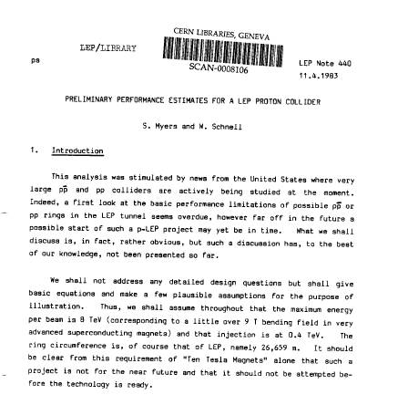
The Start:
First documented proposal

Slide 3
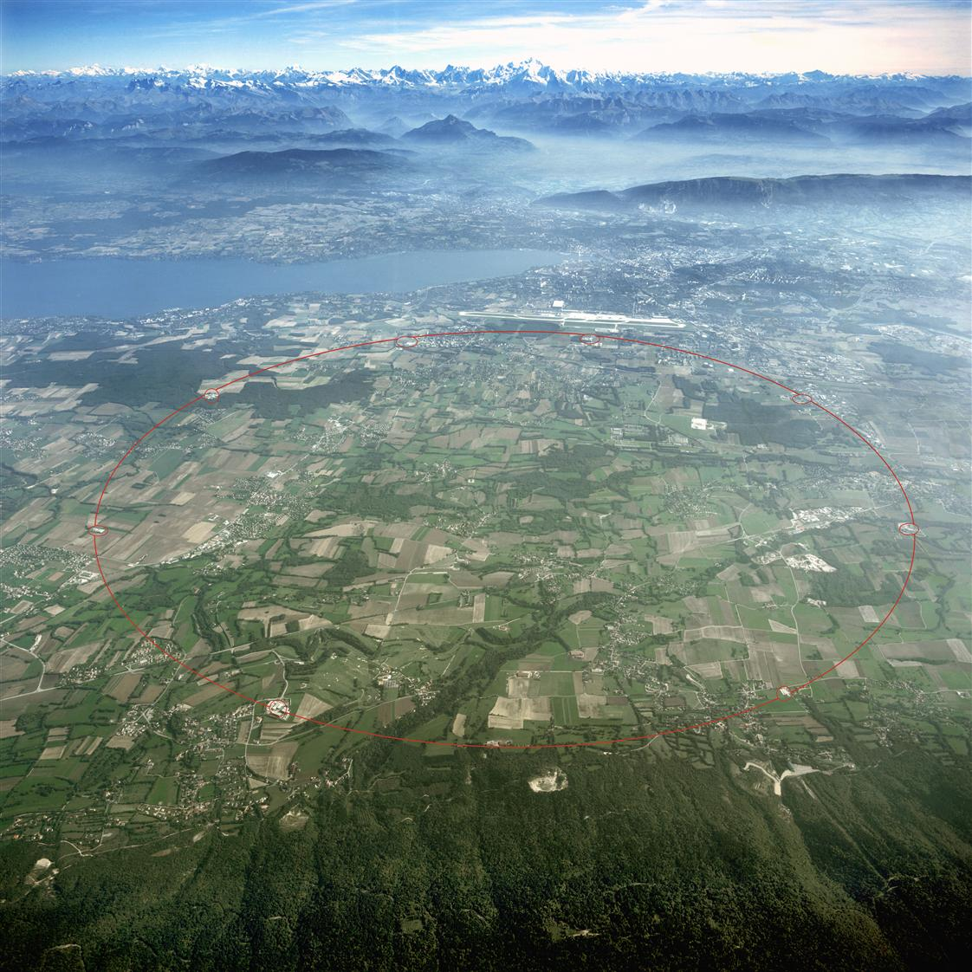
The LHC
Superconducting Proton Accelerator and Collider
installed in a 27km circumference underground tunnel (tunnel cross-section diameter 4m) at CERN
Tunnel was built for LEP collider in 1985
S. Myers QUB March 11, 2009
3
Notes:
3

Slide 4
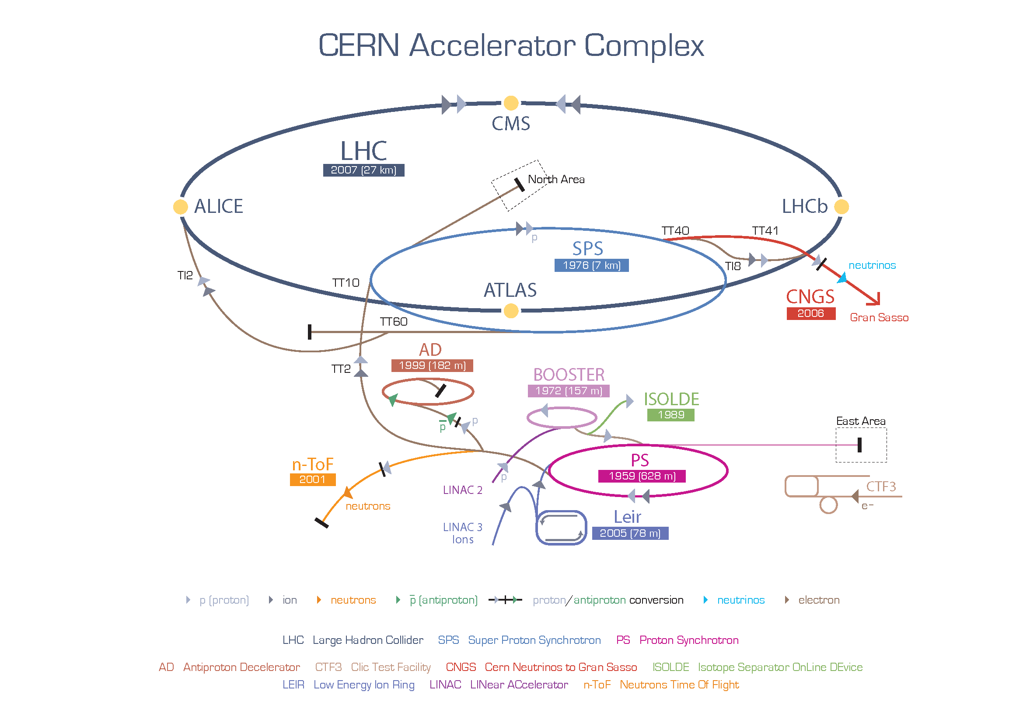
Total of 9 accelerators at CERN, 12 if you consider the 4 rings of the booster

Slide 5
Technologies needed for Accelerators and Detectors (some examples)
      Civil engineering (underground caverns and tunnelling...)
      Geodesy (align all components to accuracies not needed in any other domain.)
      Electrical distribution (fast switching and power sharing between Swiss and French networks, network protection, active compensators, susceptibility to electrical storms...)
      Cryogenics (1.9K, superfluid helium, 37Mkg of cold mass, 100 tonnes He. 1260tonnes nitrogen)
      Magnets (9T, twin bore, NbTi sc cable, ~3000 sc magnets + “normal” magnets...)
      Power converters (13kA DC conversion from AC, with 1ppm ripple, resolution,..)
      Ultra High Vacuum (10⁻⁹ to 10⁻¹¹ mbar (Torr) in the presence of beam, 27km)
      Acceleration System (sc RF 400MHz, 1MW klystrons, control of cavities wrt beam)
      Beam Instrumentation (all types of particle detection and control)
      Beam feedback (EM instabilities, detect and stabilize)
      Injection, extraction(high rise time magnetic pulses, PFN, ferrite loaded magnets, UHV)
      Machine protection (10GJ EM stored energy, 720MJ beams energy )
      Targets, dumps and collimators (materials research for particle beams)

Slide 6
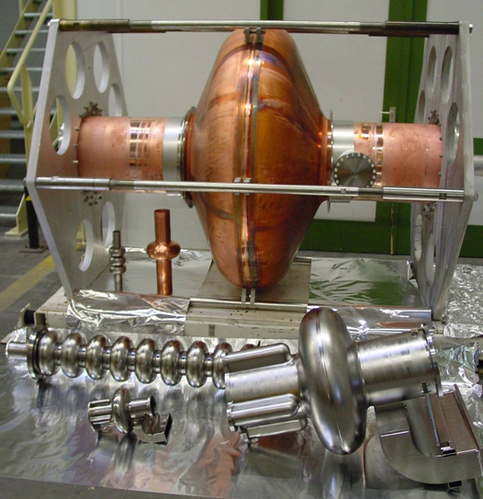
Acceleration (RF) system
Radiofrequency (RF) electric fields
RF cavities are located intermittently along the beam pipe. Each time a beam passes the electric field in an RF cavity, some of the energy from the radio wave is transferred to the particles.
S. Myers QUB March 11, 2009
6
Notes:
6

Slide 7
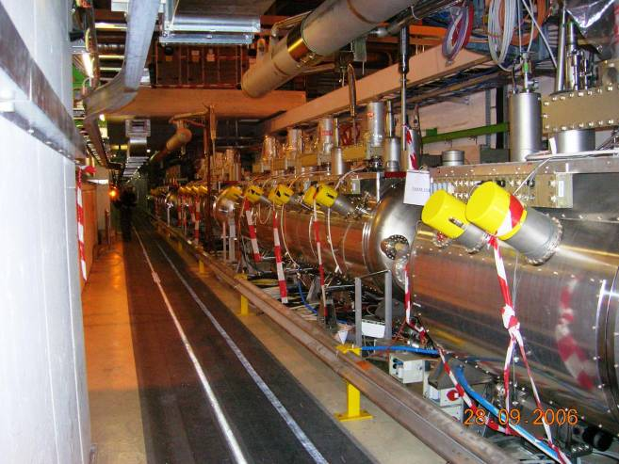
In Reality (point 4)
2 Modules per beam
4 Cavities per module
S. Myers QUB March 11, 2009
7
Notes:
7

Slide 8
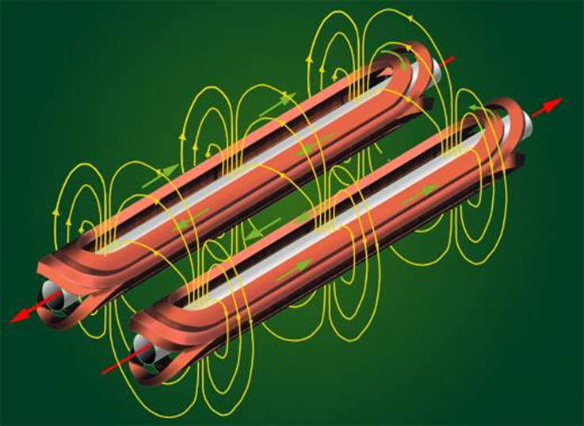
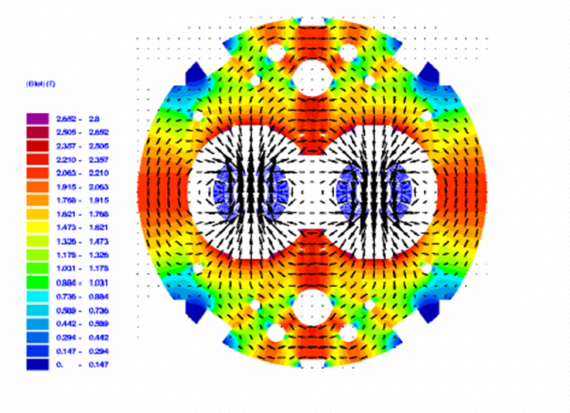
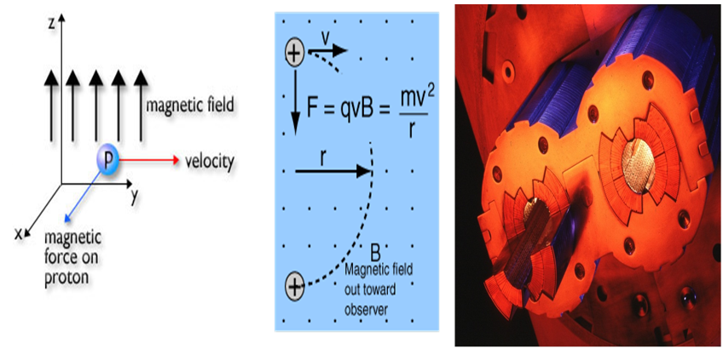
Dipole or Bending Magnets
Notes:
8

Slide 9
If the LHC did not use superconductivity
The LHC has a circumference of 26.7 km, with 20km filled with superconducting magnets operating at 8.3 T. The refrigerators producing the liquid helium to cool the magnets consume 40 MW of power.
An equivalent machine with classical electromagnets would have a circumference of 100 km and would consume 1000 MW of power.

Slide 10
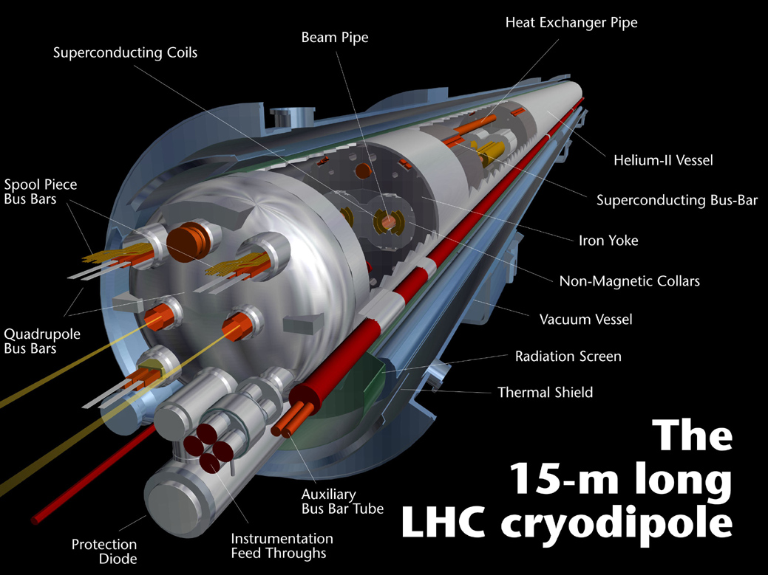
LHC dipoles (1232 of them) operating at 1.9K
Contracts by 4.7cm during cool-down
7TeV
8.33T
11850A
7MJ
S. Myers QUB March 11, 2009
10
Notes:
10

Slide 11
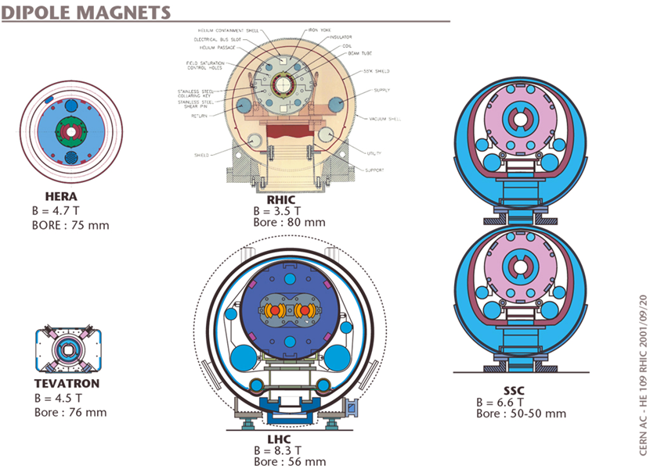
Superconducting Dipoles from Recent Colliders

Slide 12
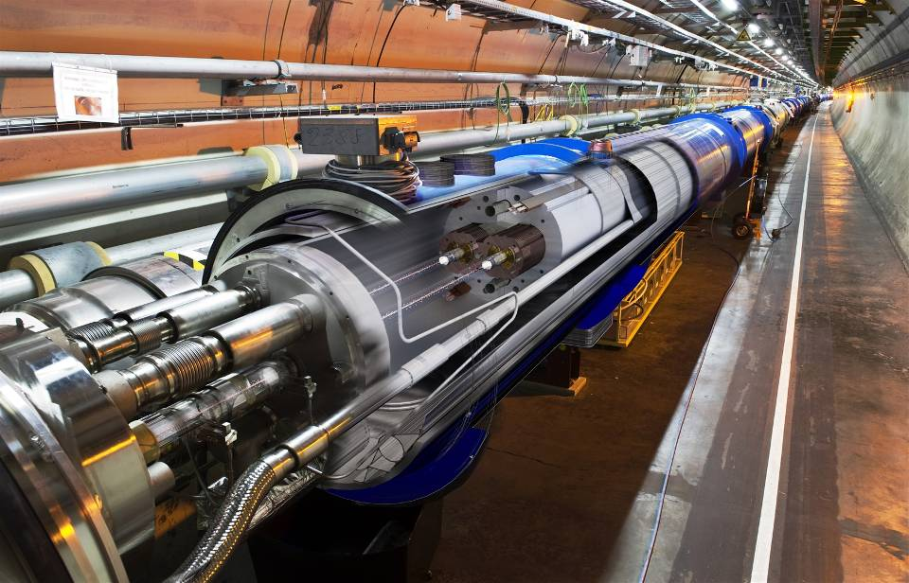
The LHC tunnel with dipole magnets
beam tubes
Notes:
12

Slide 13
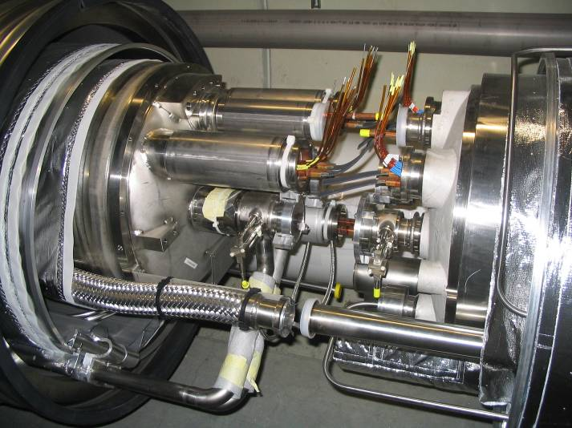
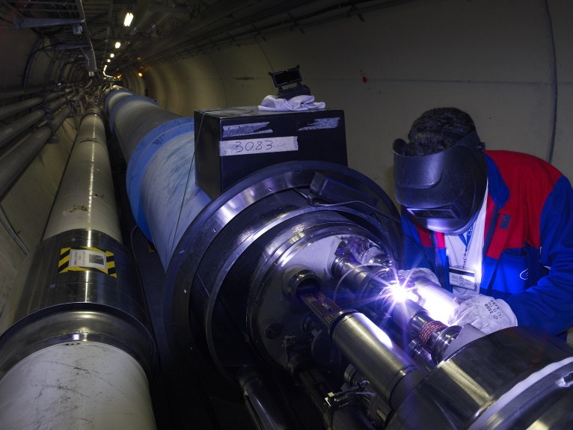
Interconnections
During cool-down of the LHC the machine contracts by 80 metres, 10m per octant
  Vacuum continuity
  Electrical connections
S. Myers QUB March 11, 2009
Notes:
13

Slide 14
LHC: Some of the Technical Challenges
Circumference (km) | 26.7 | 100-150m underground
Number of Dipoles | 1232 | Cable Nb-Ti, cold mass 37million kg
Length of Dipole (m) | 14.3
Dipole Field Strength (Tesla) | 8.4 | Results from the high beam energy needed
Operating Temperature (K) | 1.9 | Superconducting magnets needed for the high magnetic field Super-fluid helium
Current in dipole sc coils (A) | 13000 | Results from the high magnetic field 1ppm resolution
Beam Intensity (A) | 0.5 | 2.2.10⁻⁶ loss causes quench
Beam Stored Energy (MJoules) | 362 | Results from high beam energy and high beam current 1MJ melts 2kg Cu
Magnet Stored Energy (MJoules)/octant | 1100 | Results from the high magnetic field
Sector Powering Circuit | 8 | 1612 different electrical circuits

Slide 15
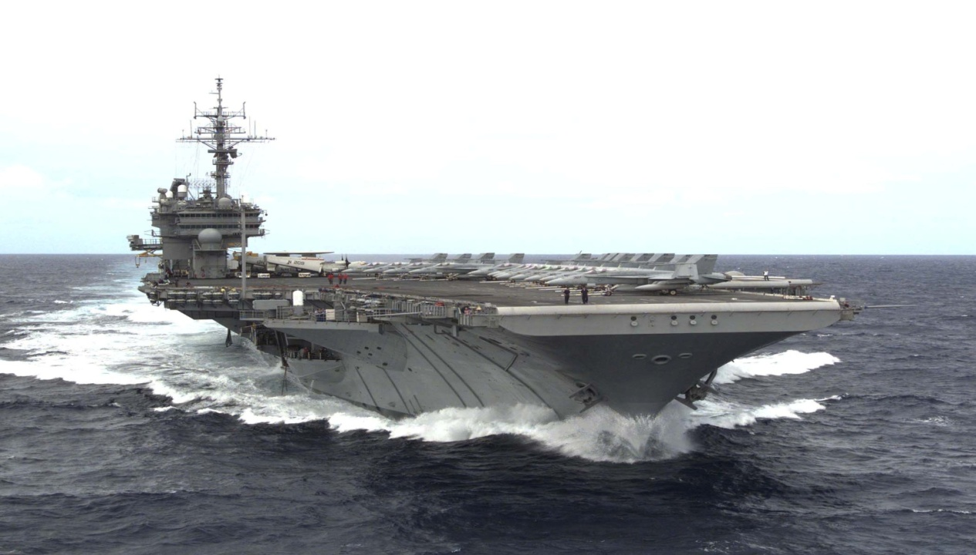
How Much Energy is this?
Nimitz class aircraft carrier (90 000 tons) at battle-speed of 30 Knots; Energy = ½ mv² ~ 10GJ
Energy stored in the magnets 10 GJ (1100 MJ/octant)
In LHC we must dump the magnetic energy in around 40 seconds i.e. stop the aircraft carrier in 40 seconds
Energy stored in each beam 362 MJ (in 89us) 4TW (power)
Copper
Melting point 1356 K
Specific heat capacity 386 J kg⁻¹ K⁻¹
Latent heat of fusion 205000 J kg⁻¹
So to heat and melt 1kg takes (1354*386+205000) J =0.73MJ
362MJ could heat and melt half a tonne (500kg) of copper
A very thin long hole

Slide 16
How to Deal with the LHC self Destructive Power
In case of a problem the stored energy in the magnets and in the beam must be transferred to and dissipated in a safe, clearly defined place
Magnet Protection system
  “Quench” Protection (measures resistance)
  Energy dump triggered and energy dissipated as heat in resistors (after of course aborting the beams)
Machine Protection System
  All critical elements which could provoke a beam loss are equipped with an emergency beam abort signal which triggers the beam dump system. There is also a beam loss monitoring system all around the circumference which will abort the beam if anomalous losses occur
  The beam dump system is the last safety net

Slide 17
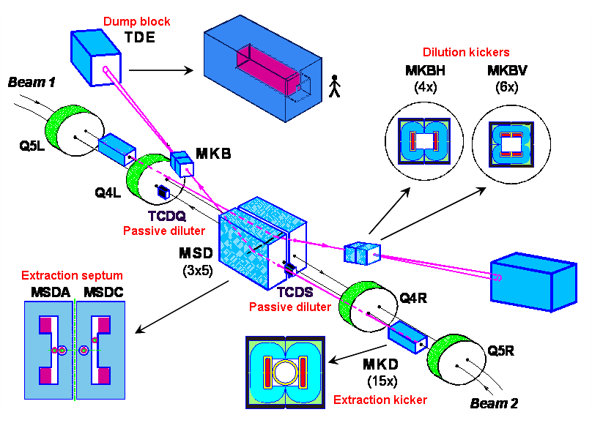
LHC beam dump principle (and acronyms)

Slide 18
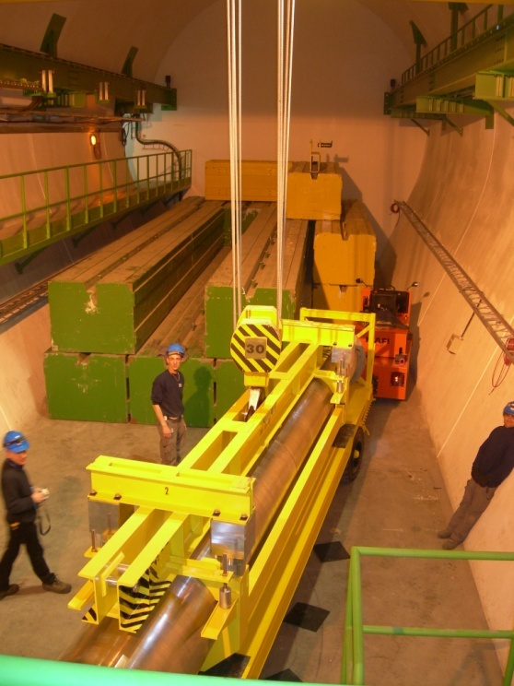
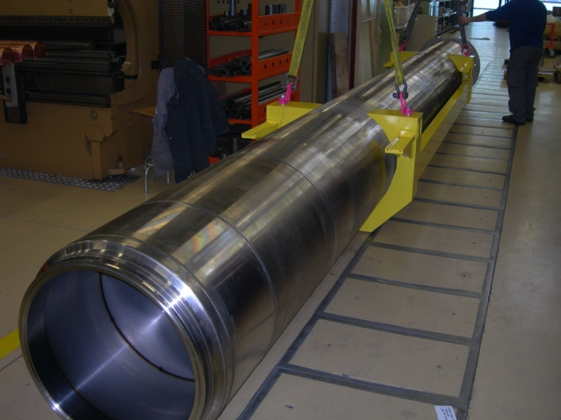
Beam dump core (TDE)
7.7m long, 700 mm ∅ graphite core
Graded density of 1.1 g/cm³ and 1.7 g/cm³
12 mm wall, stainless-steel welded pressure vessel, filled with 1.2 bar of N₂
Surrounded by ~1000 tonnes of concrete/steel radiation shielding blocks
0.7 m
3.5 m
3.5 m
beam
1.7 g/cm³
1.1 g/cm³
1.7 g/cm³

Slide 19
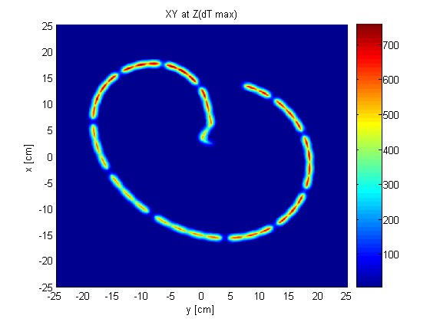
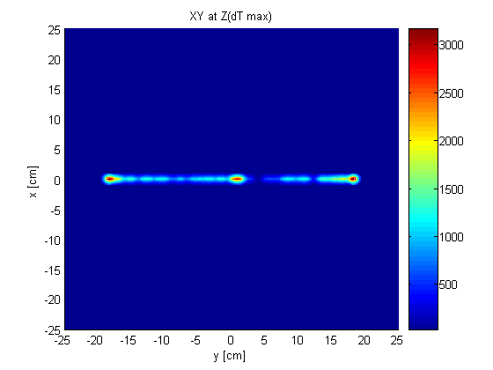
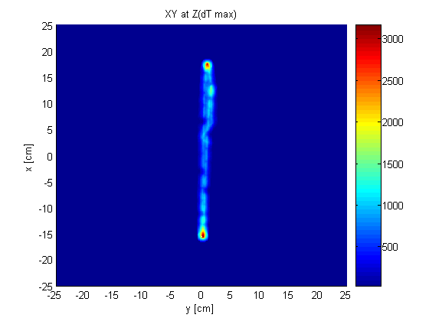
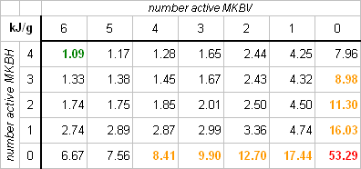
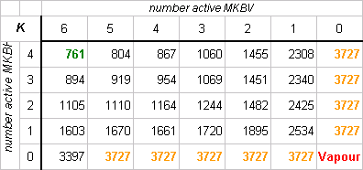
Beam dump core with dilution failures
Nominal
0/6 vertical diluters
0/4 horizontal diluters
Nominal beam intensity (3.2×10¹⁴ p+)
Maximum energy density in dump block
Maximum temperature rise in dump block
31 kJ/g for onset of sublimation, 60 kJ/g for complete vaporization

Slide 20
Collimation

Slide 21
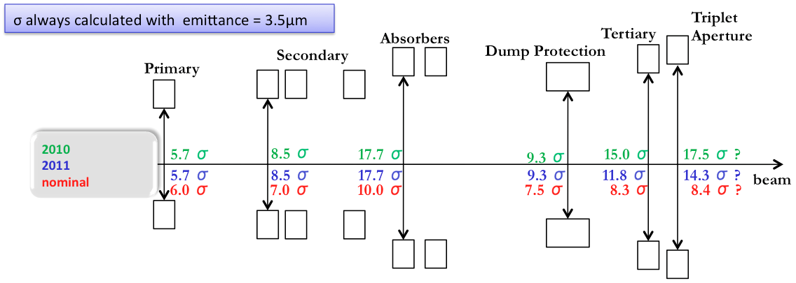
Collimator settings 2012
2012: tight settings
Collimation hierarchy has to be respected in order to achieve satisfactory protection and cleaning
 | σ
TCP 7 | 4.3
TCSG 7 | 6.3
TCLA 7 | 8.3
TCSG 6 | 7.1
TCDQ 6 | 7.6
TCT | 9.0
Aperture | 10.5

Slide 22
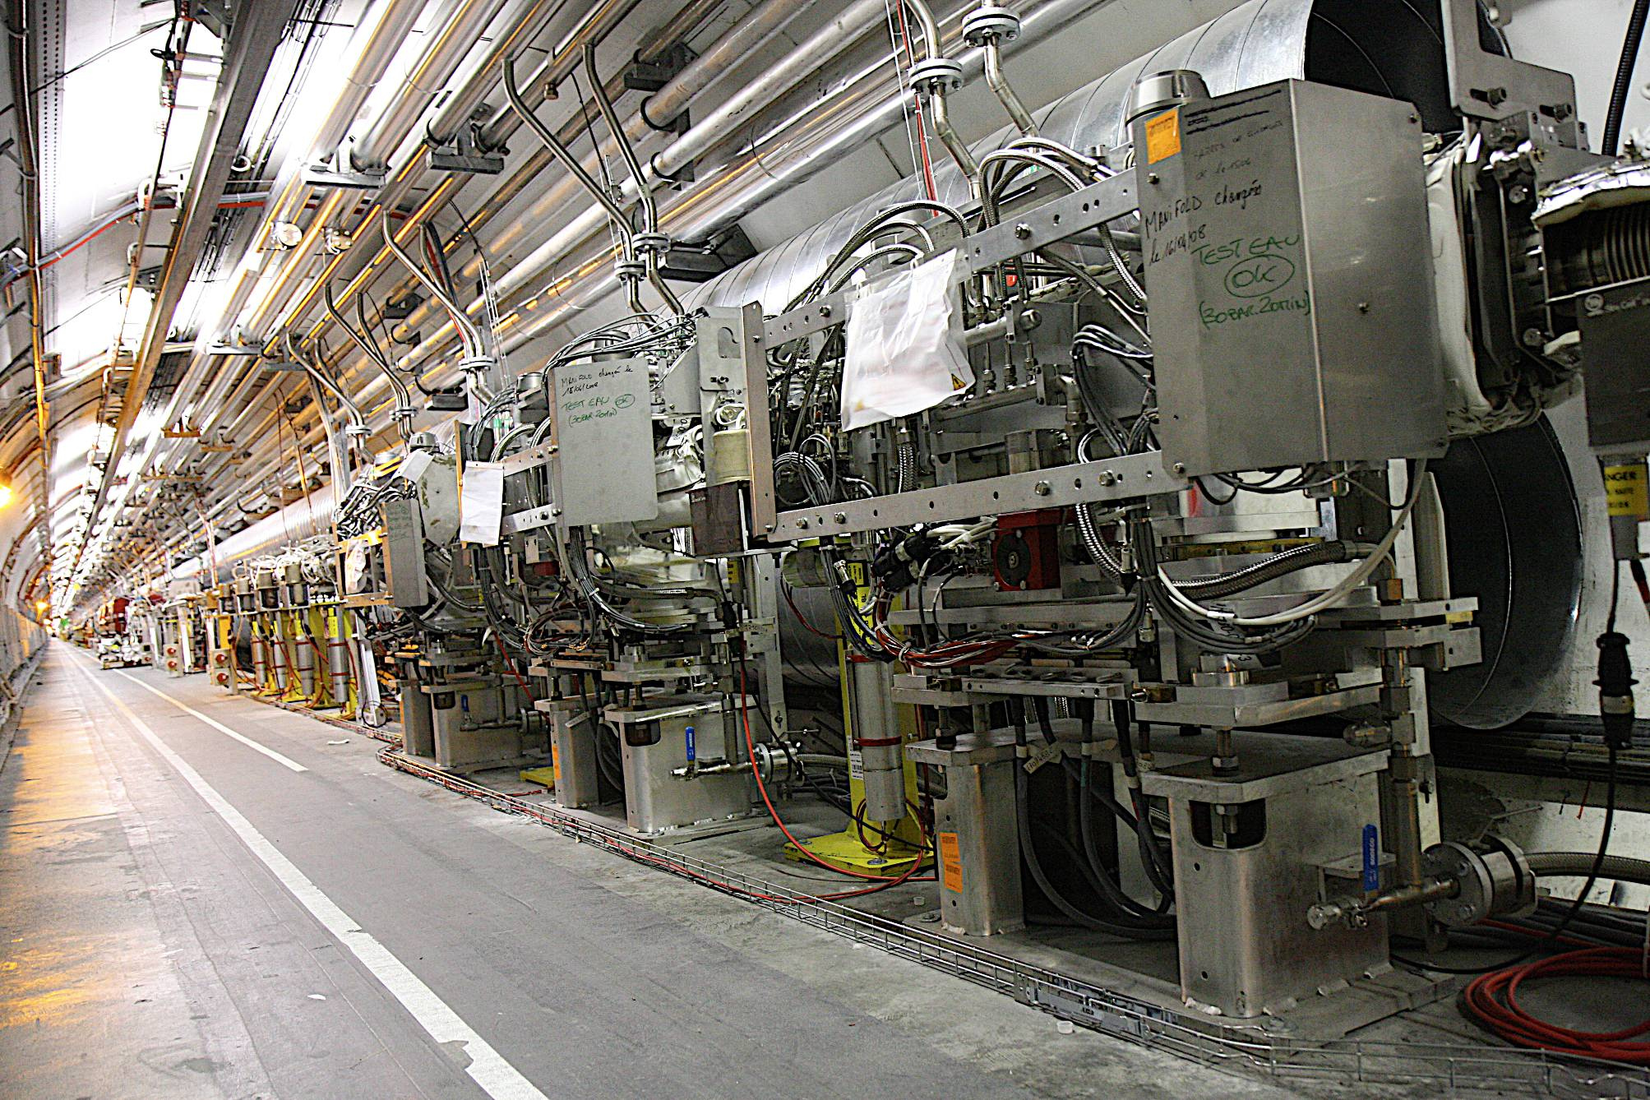
Collimators (points 3 and 7)
Intercept particles that have strayed outside acceptable limits
56.0 mm
1 mm
22
Notes:
22

Slide 23
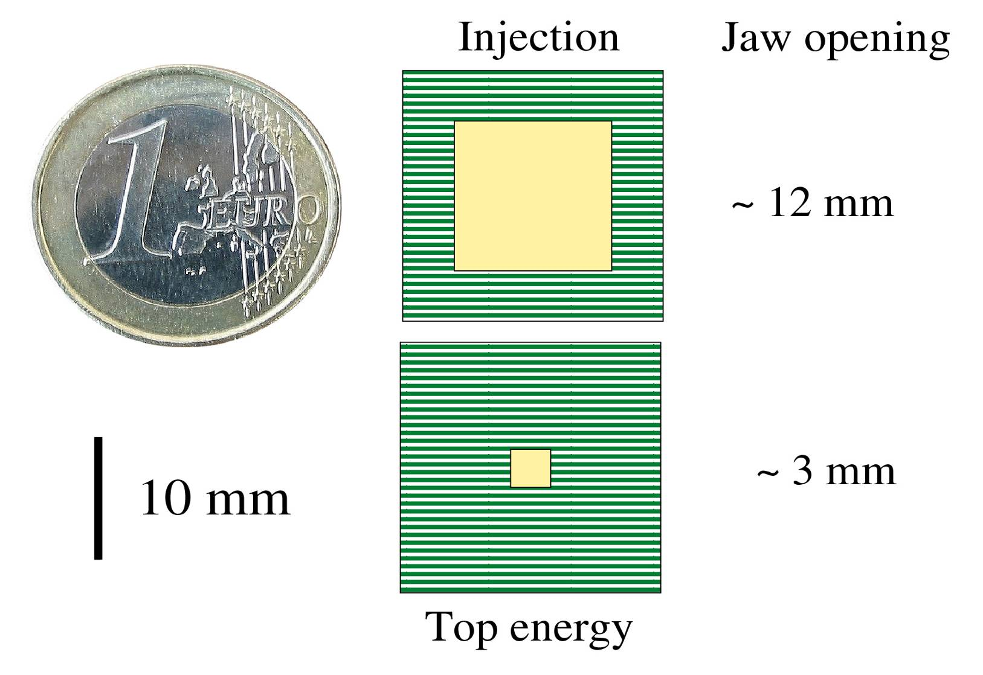
Collimating with small gaps
LHC beam will be physically quite close to collimator material and collimators are long (up to 1.2 m)!

Slide 24
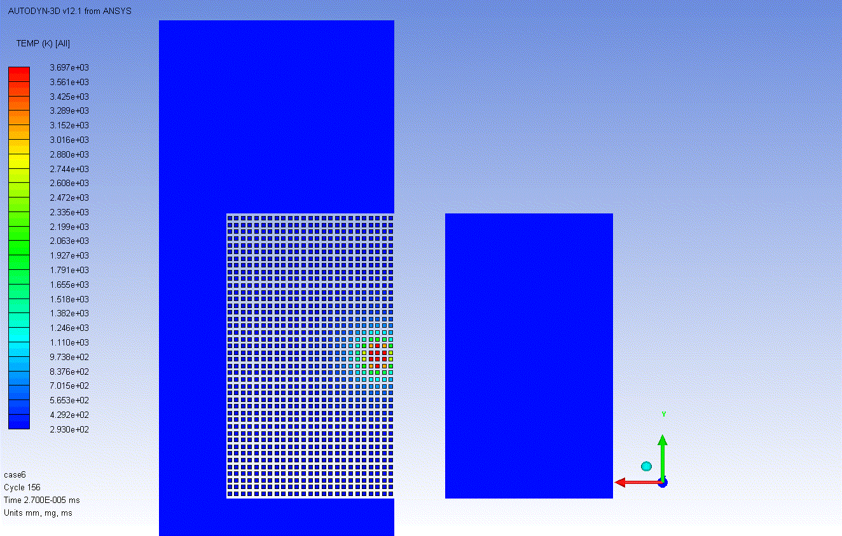
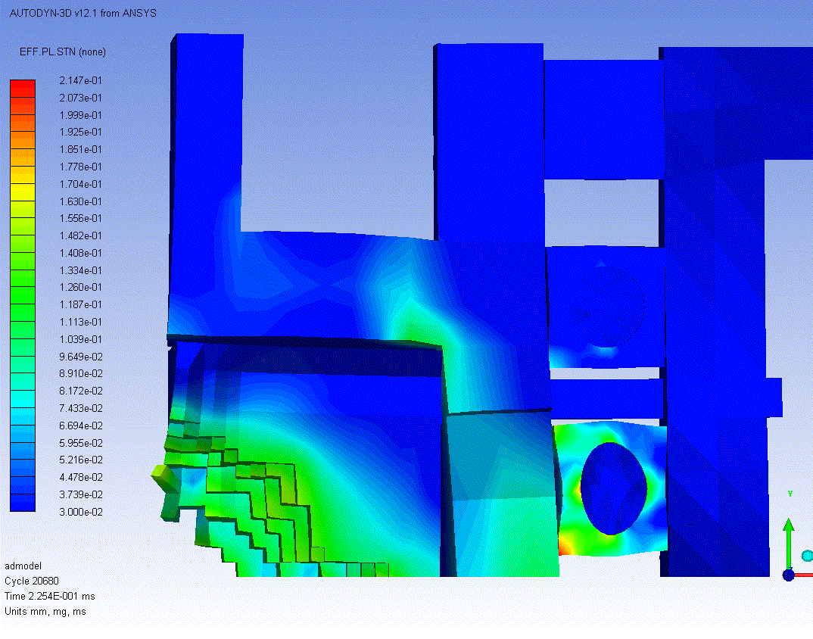
Accident Simulations for TCT
Damage Level 3 (Catastrophic Damage)
Case 7 (8 bunches at 5 TeV) is the only studied case falling in Damage Level 3.
High probability of water leakage due to very severe plastic deformations on pipes.
Impressive jaw damage :
  Extended eroded and deformed zone.
  Projections of hot and fast solid tungsten bullets (T≈2000K, V_{max} ≈ 1 km/s) towards opposite jaw. Slower particles hit tank covers (at velocities just below ballistic limit).
  Risk of “bonding” the two jaws due to the projected resolidified material.
Real Scale Deformations !!

Slide 25
Accident Simulations for TCT
Damage Level 3 (Catastrophic Damage)
Case 7 (8 bunches at 5 TeV) is the only studied case falling in Damage Level 3.
High probability of water leakage due to very severe plastic deformations on pipes.
Impressive jaw damage :
  Extended eroded and deformed zone.
  Projections of hot and fast solid tungsten bullets (T≈2000K, V_{max} ≈ 1 km/s) towards opposite jaw. Slower particles hit tank covers (at velocities just below ballistic limit).
  Risk of “bonding” the two jaws due to the projected resolidified material.
Real Scale Deformations !!

Slide 26
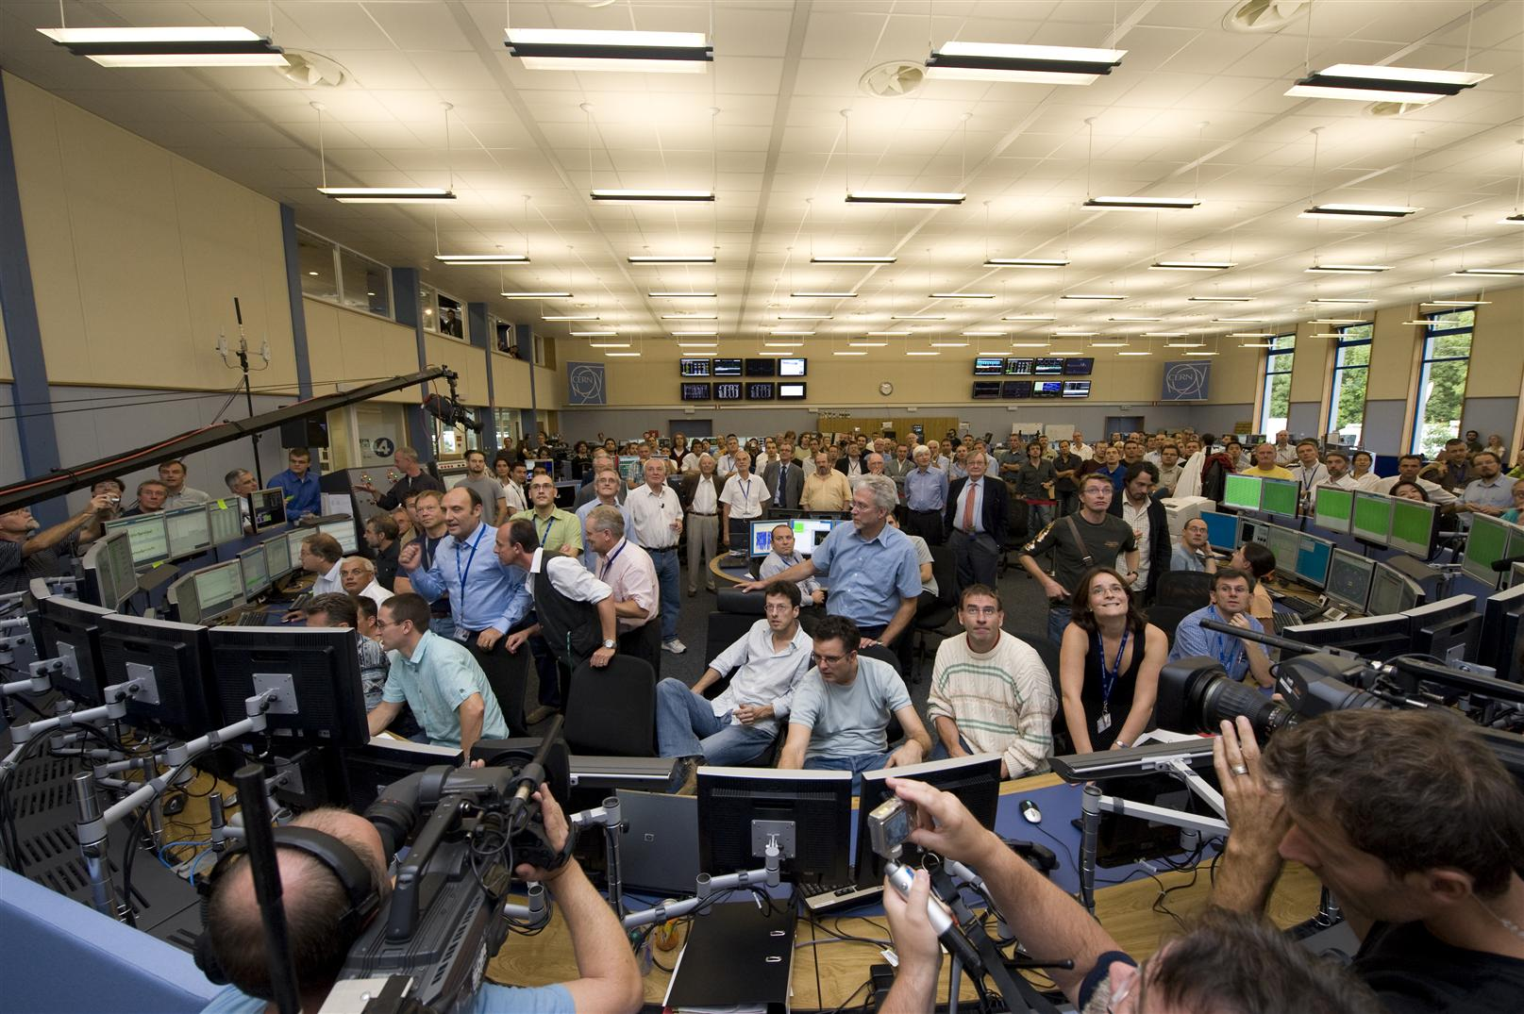
September 10, 2008; It worked!

Slide 27
And 9 days later
  Making the last step of dipole circuit in sector 34, to 9.3kA
  At 8.7kA, development of resistive zone in the dipole bus bar splice between Q24 R3 and the neighbouring dipole
  Electrical arc developed which punctured the helium enclosure
One inter-magnet connector (out of 100,000) was badly soldered and…
The magnet protection system did not protect
27
Notes:
27

Slide 28
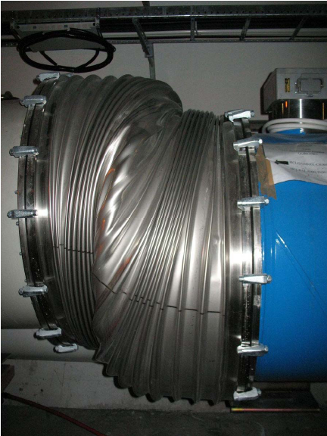

Consequences
28
Notes:
28

Slide 29
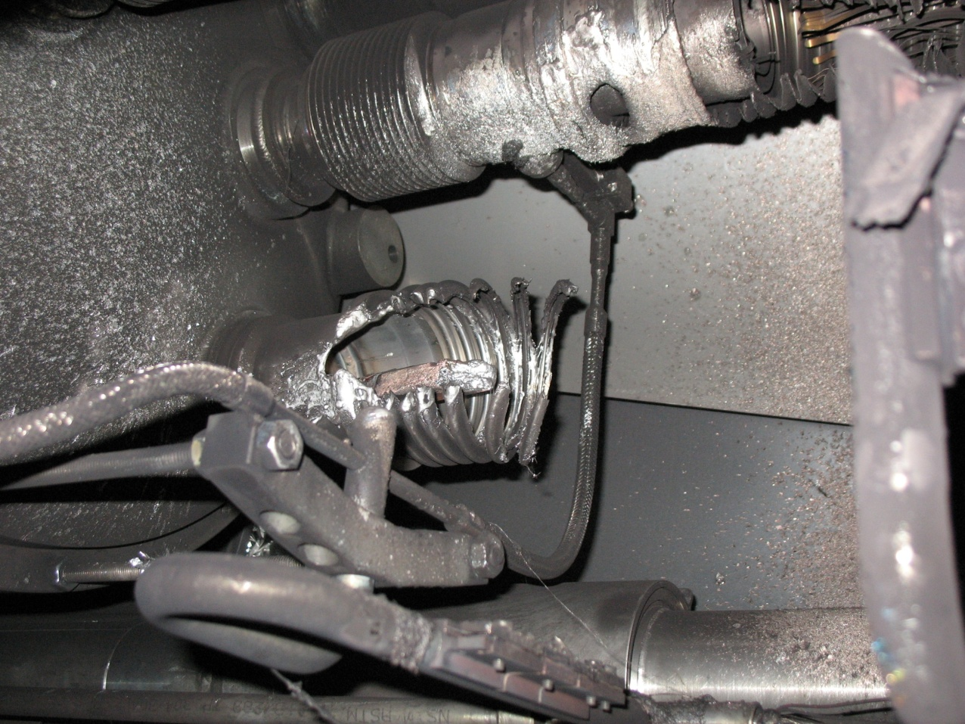
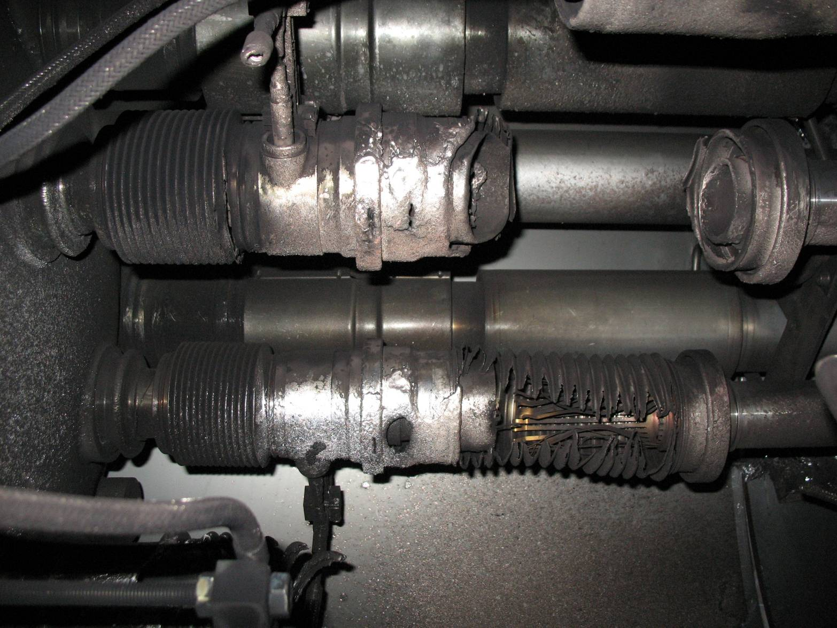
Electrical arc between C24 and Q24
V lines
M3 line

Slide 30
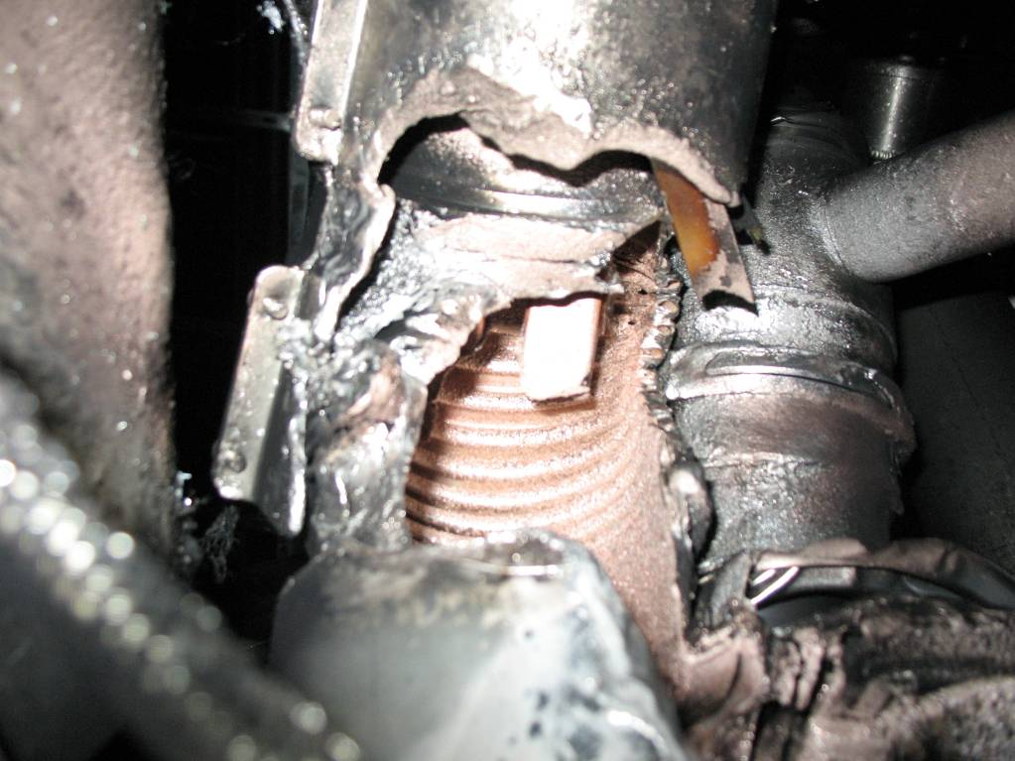
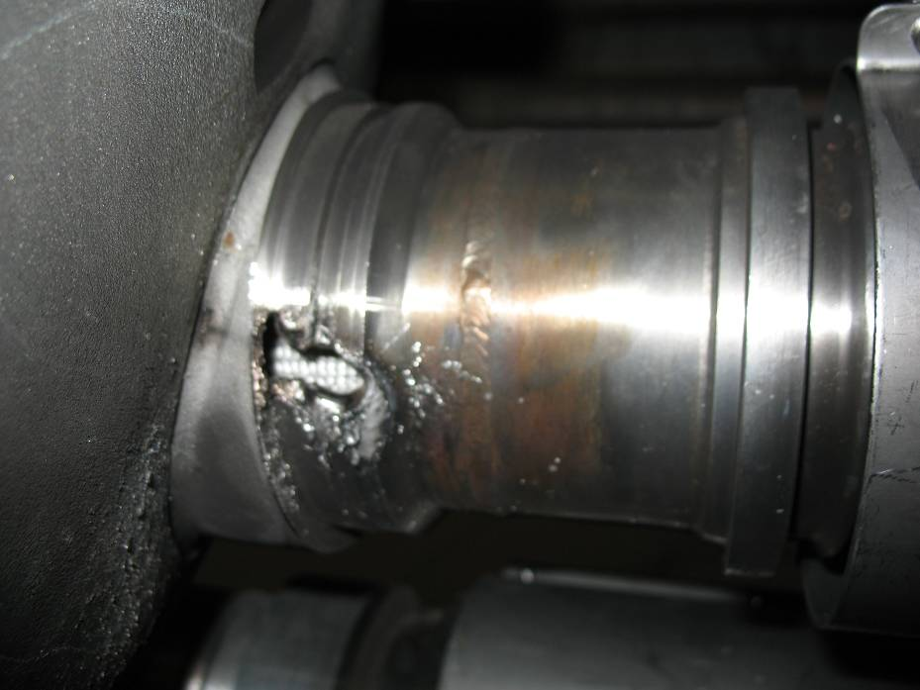
Collateral damage: secondary arcs
QBBI.B31R3 M3 line
QQBI.27R3 M3 line

Slide 31
Bus bar splice
31
Notes:
31

Slide 32
Fault tree [1/3]
What went wrong?
Observed on magnet
Absence of soldering
No sensitive detection on bus bar
Resistance 220 nOhm
Bad contact with stabilizer
Electro-thermal model
Thermal runaway
Meltdown, open circuit
Power converter fast discharge
Electrical arc

Slide 33
Fault tree [2/3]
Electrical arc
He vessel perforation
Beam pipe perforation
Soot
He discharge in insulation vacuum
Inadequate sizing of relief devices (MCI)
Loss of beam vacuum
Contamination by soot
Blast
ODH in tunnel
Mechanical damage to MLI
Pressurization of vacuum enclosures
Trip AUG
Break vent door
Contamination by MLI

Slide 34
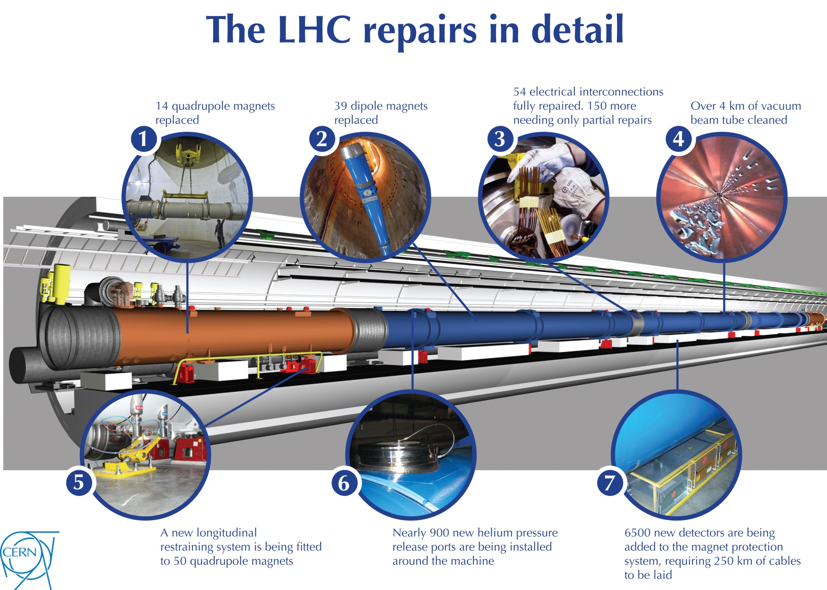
But this repair would not allow 14TeV but operation at reduced energy (7-8TeV)
+ 8 cryogenics!

Slide 35
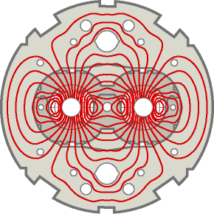
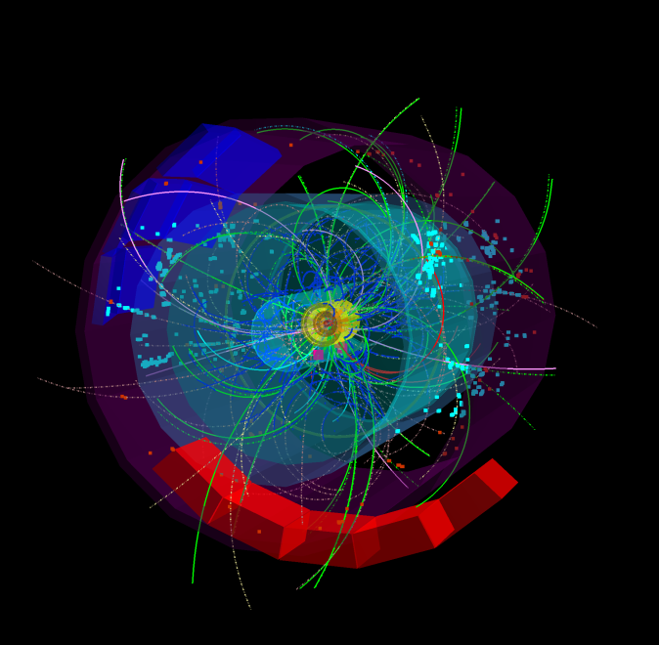
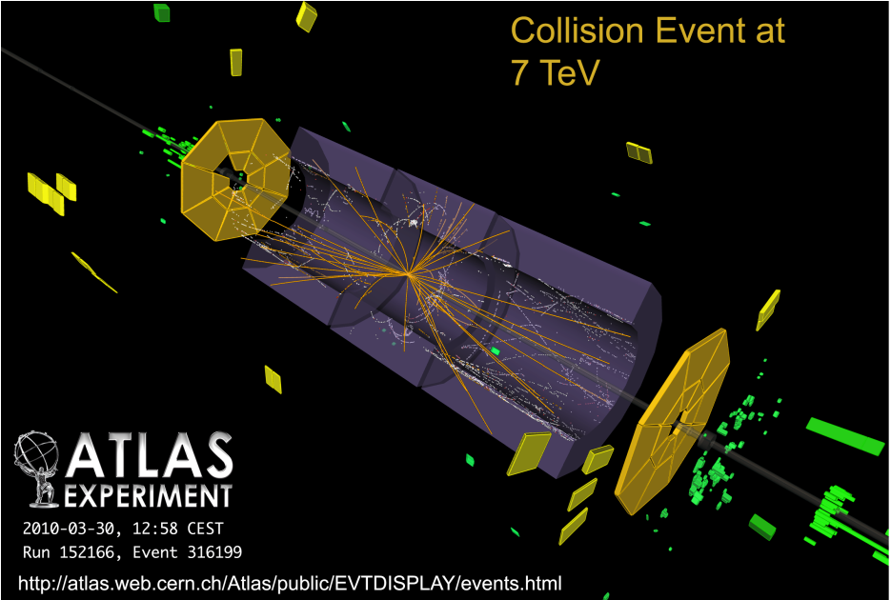
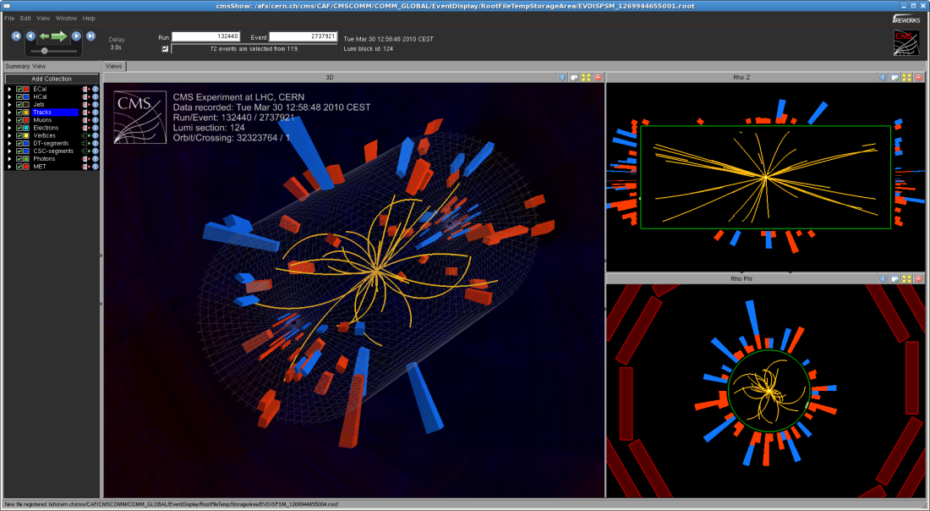
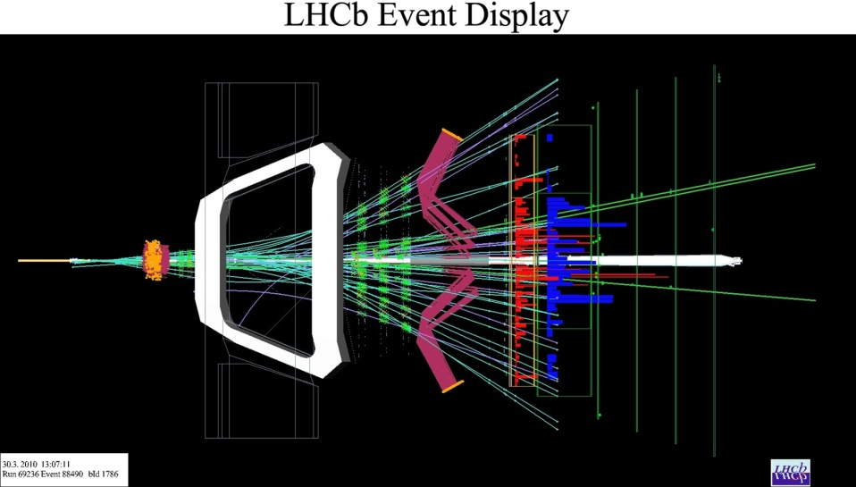
LHC: First collisions at 7 TeV on 30 March 2010
ALICE
LHCb
CMS

Slide 36
Performance in 2010

Slide 37
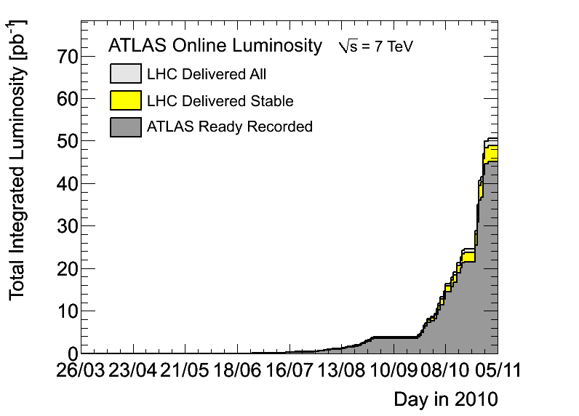
Integrated Luminosity in 2010
45pb-1 recorded

Slide 38
Performance in 2011

Slide 39
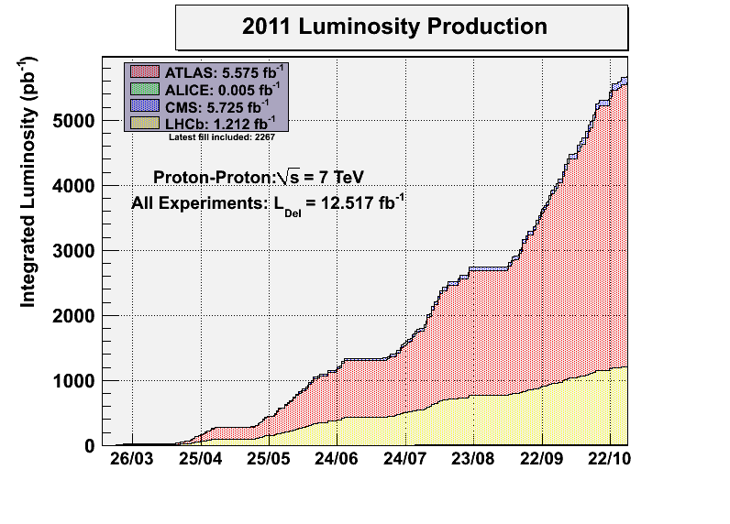
Protons
~ 6000 fb-1
Goal 2011

Slide 40
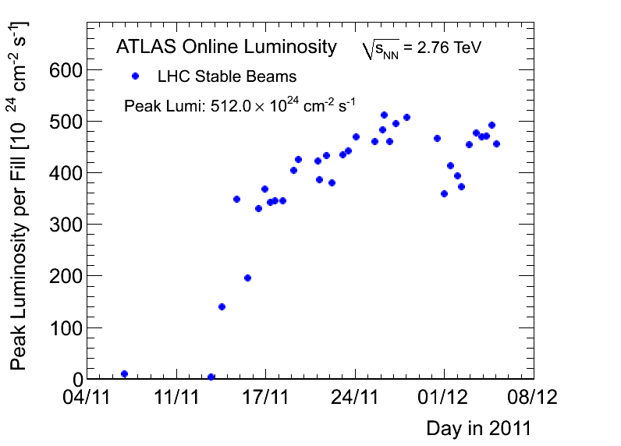
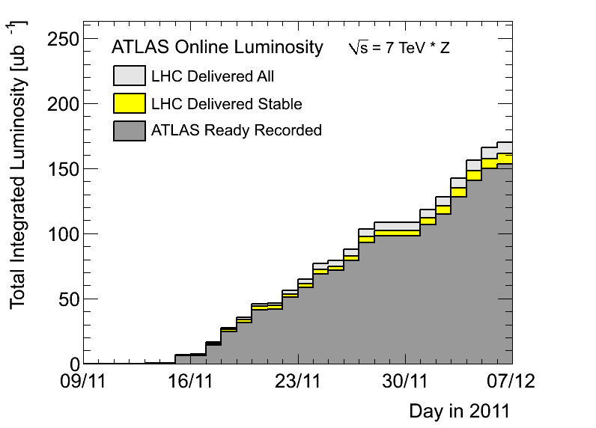
Ions
Peak and Integrated luminosity
2010
2010
In 2010:
Peak ~18E24; Integrated ~18ub-1
Max 137 bunches, larger β*, smaller bunch intensities
356 bunches

Slide 41
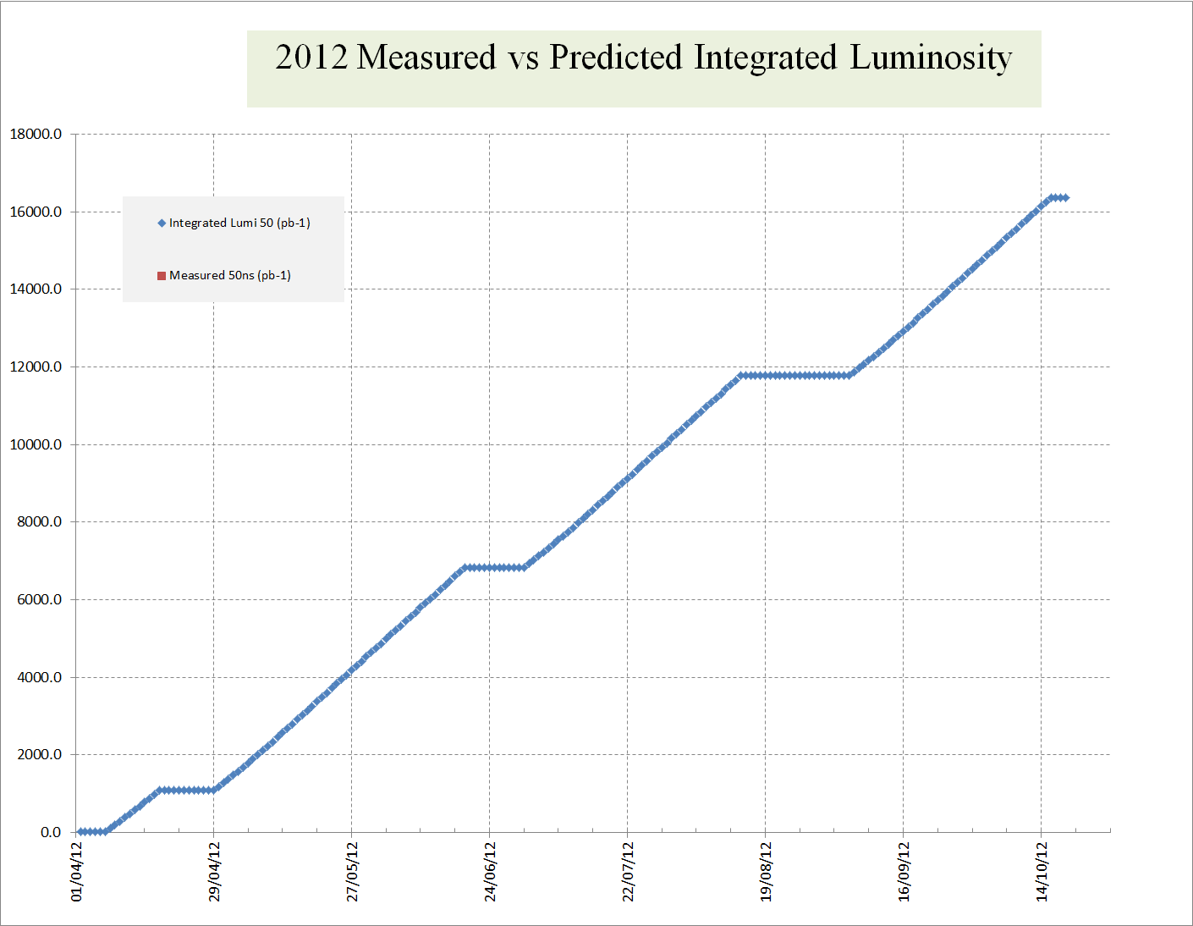
Estimated Luminosity needed for Higgs
October 2011

Slide 42
2012 Priorities
The LHC machine must produce enough integrated luminosity to allow ATLAS and CMS to independently discover the Higgs before the start of LS1.
We must also prepare for the proton-lead ion run at the end of the year.
We must (in 2012) do the necessary machine experiments to allow high energy, useful high luminosity running after LS1.

Slide 43
Performance in 2012

Slide 44
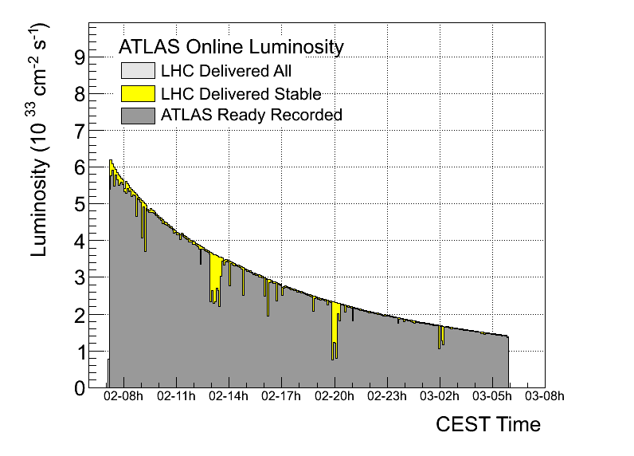
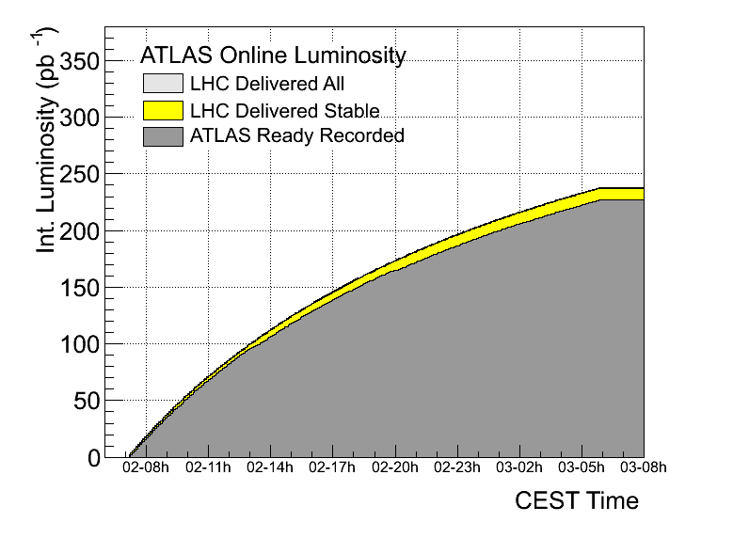
Saturday 2nd June
Fill 2692 (238pb-1 in 23 hours)
Integral of all of 2010
now in 2.5 hours

Slide 45
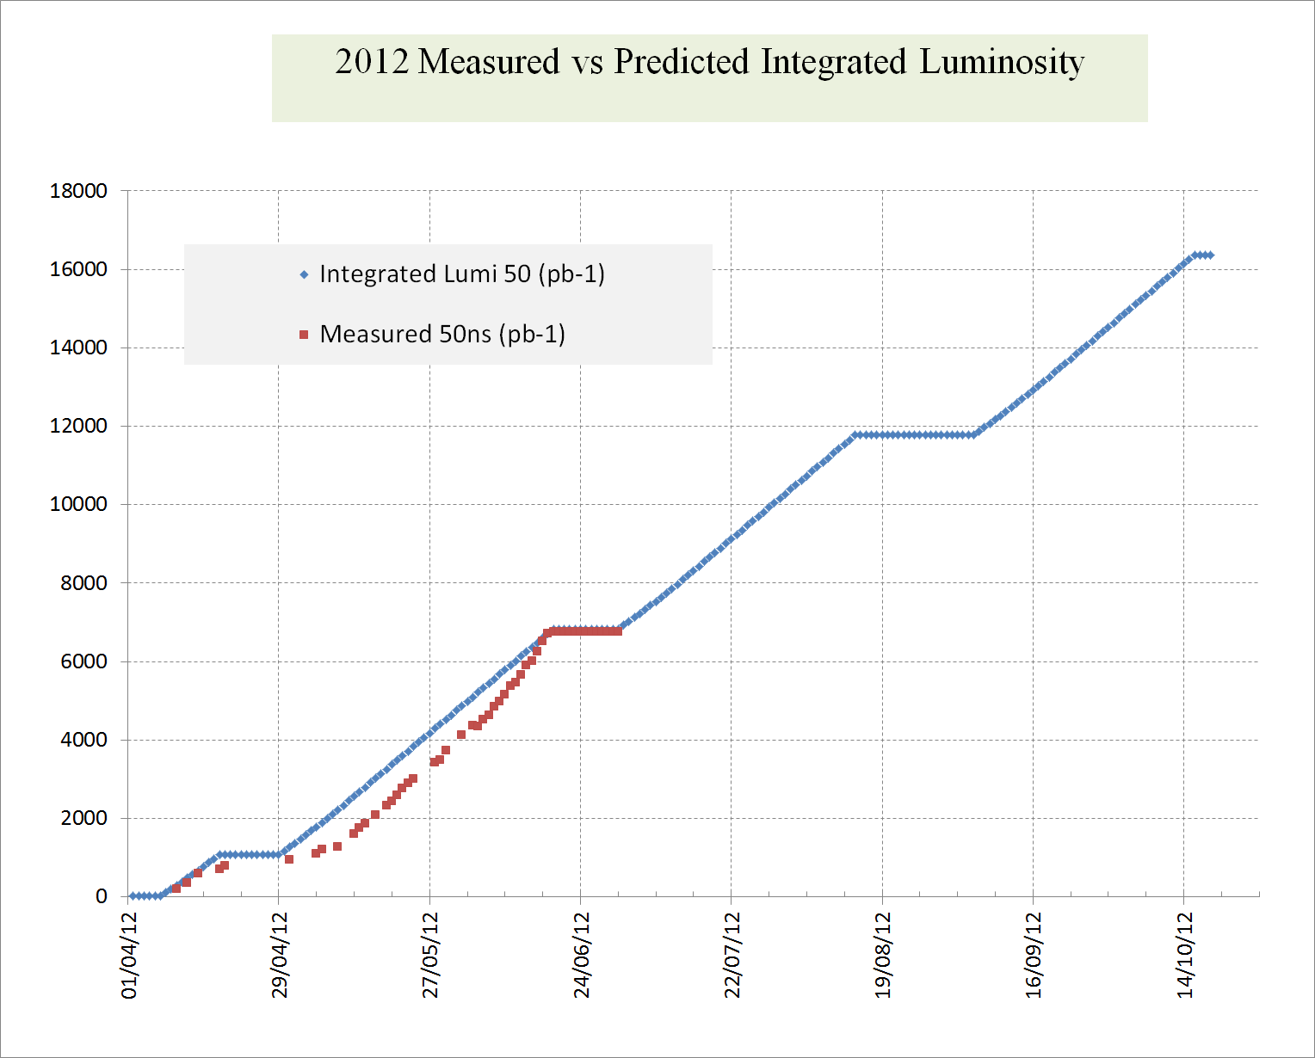
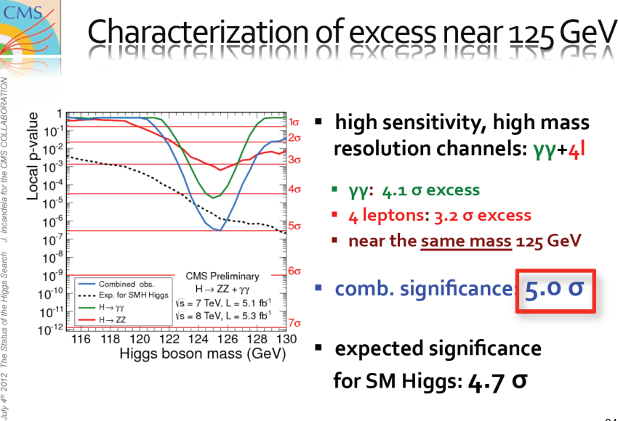
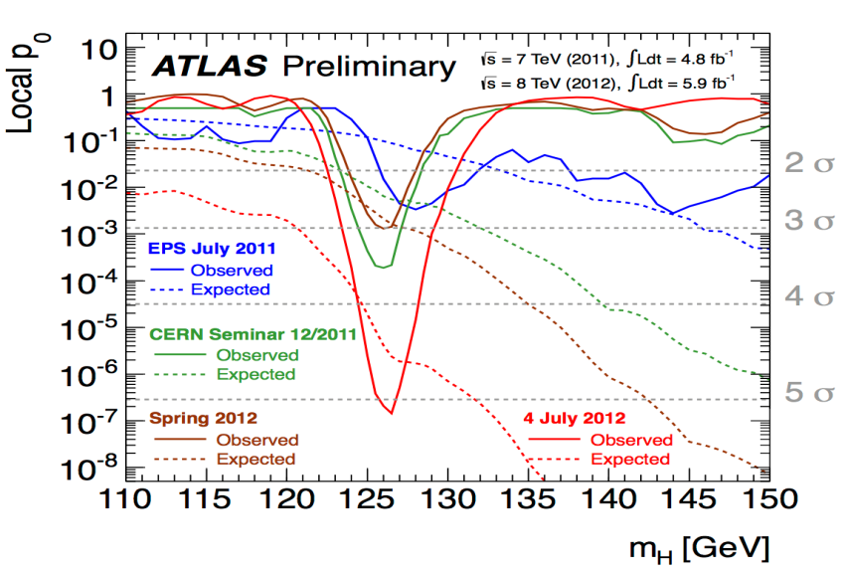
Mid 2012: With Respect to estimates
4th July: Melbourne/CERN

Slide 46
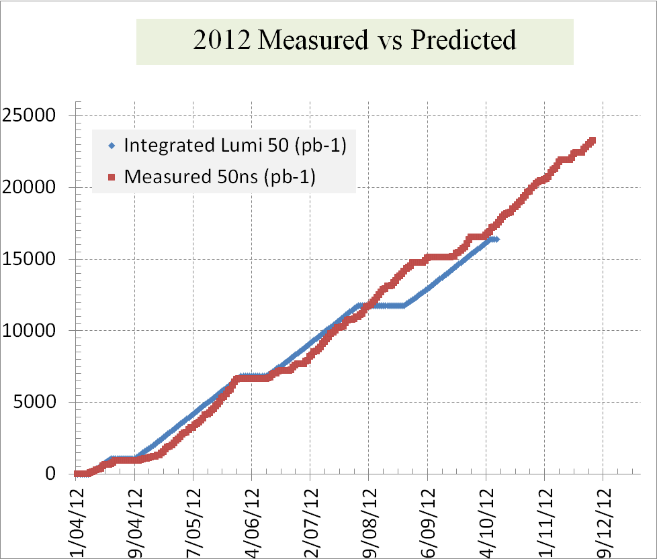
2012

Slide 47

Last 3 years

Slide 48
Tests towards the end of 2012
25 ns tests
    Electron cloud and vacuum (scrubbing)
    Crossing angle, aperture, beam-beam, min β*
    UFOs
    HOM heating
    Short Physics run with Maximum pile up?
Comparison 25 vs 50 ns
    β* levelling testing (already tested in Machine studies)

Slide 49
FUTURE

Slide 50
LS1 then operation around 7TeV/beam
LS1 Work
  Repair defectuous interconnects
  Consolidate all interconnects with new design
  Finish off pressure release valves (DN200)
  Bring all necessary equipment up to the level needed for 7TeV/beam

Slide 51
LHC MB circuit splice consolidation proposal
Phase I
Surfacing of bus bar and installation of redundant shunts by soldering
Phase II
Application of clamp and reinforcement of nearby bus bar insulation
Phase III
Insulation between bus bar and to ground, Lorentz force clamping

Slide 52

Linear schedule
EDMS 1227656 (rev1.0, July 26th, 2012)
No contingency

Slide 53
Then operation at 6.5TeV per beam
Assumptions
E=6.5TeV
β* = 0.5m (maybe 0.4)
All other conditions as in 2012 i.e. LHC availability same etc

Slide 54
Mid-Term Future
HL-LHC

Slide 55





Two Reasons for upgrade:
Performance & Technical (Consolidation)
Shut down to fix interconnects and overcome energy limitation (LHC incident of Sept 2008) and R2E
Full upgrade
Shut down to overcome beam intensity limitation (Injectors, collimation and more…)

Slide 56


Final goal : 3000 fb⁻¹ by 2030’s…
5 10³⁴ levelled lumi
(25 10³⁴ virtual peak lumi)
140 pile up (average)
3 fb-1 per day
60% of efficiency
250 fb-1 /year
300 fb-1/year as «ultimate»
Full project
Just continue improving
performance through
vigorous consolidation

Slide 57
Official Beam Parameters
(see PLC by O.Bruning)
Parameter | nominal | 25ns | 50ns
N | 1.15E+11 | 2.2E+11 | 3.5E+11
n_{b} | 2808 | 2808 | 1404
beam current [A] | 0.58 | 1.12 | 0.89
x-ing angle [μrad] | 300 | 590 | 590
beam separation [σ] | 10 | 12.5 | 11.4
β* [m] | 0.55 | 0.15 | 0.15
ε_{n} [μm] | 3.75 | 2.5 | 3.0
ε_{L} [eVs] | 2.51 | 2.5 | 2.5
energy spread | 1.20E-04 | 1.20E-04 | 1.20E-04
bunch length [m] | 7.50E-02 | 7.50E-02 | 7.50E-02
IBS horizontal [h] | 80 -> 106 | 20.0 | 20.7
IBS longitudinal [h] | 61 -> 60 | 15.8 | 13.2
Piwinski parameter | 0.68 | 3.1 | 2.9
geom. reduction | 0.83 | 0.35 | 0.33
beam-beam / IP | 3.10E-03 | 3.9E-03 | 5.0E-03
Peak Luminosity | 1 10³⁴ | 7.4 10³⁴ | 8.5 10³⁴
Virtual Luminosity | 1.2 10³⁴ | 21 10³⁴ | 26 10³⁴
6.2 10¹⁴ and 4.9 10¹⁴
p/beam
sufficient room for leveling
(with Crab Cavities)
Virtual luminosity (25ns) of
L = 7.4 / 0.35 10³⁴ cm⁻² s⁻¹
= 21 10³⁴ cm⁻² s⁻¹ (‘k’ = 5)
Virtual luminosity (50ns) of
L = 8.5 / 0.33 10³⁴ cm⁻² s⁻¹
= 26 10³⁴ cm⁻² s⁻¹ (‘k’ = 10)
(Leveled to 5 10³⁴ cm⁻² s⁻¹
and 2.5 10³⁴ cm⁻² s⁻¹)
28
Events / crossing (peak & leveled L) | 19 | 210 | 475 | 140 | 140

Slide 58
HiLumi: Two branches (with overlap)
FP- Full Performance upgrade (3000 fb⁻¹)
  Crab Cavities
  HB feedback system (SPS)
  Advanced collimation systems
  E-lens (?)
  SC links (all)
  R2E and remote handling for 3000 fb⁻¹
PIC - Performance Improving Consolidation upgrade (∼1000 fb⁻¹)
  IR quad change (rad. Damage, enhanced cooling)
  Cryogenics (P4, IP4,IP5) separation Arc -RF and IR(?)
  Enhanced Collimation (11T?)
  SC links (in part) and rad. Mitigation (ALARA)
  QPS and Machine Prot.
    Kickers
    Interlock system

Slide 59

Being Reviewed at present
2022
LS3
Installation of the HL-LHC hardware

Slide 60
Long-Term Future:
VHE-LHC, e+e-, and ep options

Slide 61

HE-LHC and VHE-LHC
This large tunnel would also allow e+e- (TLEP) and e-p collisions as well as pp collisions
HE-LHC dipole design will piggy back on the high gradient quadrupole R&D needed for HL-LHC
  Would allow an increase in energy by factor of 2-2.5
VHE-LHC (??SSC) needs a 80-100km tunnel
  In conjunction with the high field magnets would allow a factor of (2-2.5)x(80/27) = 6-7.5 times LHC (42-52 TeV/beam)

Slide 62

Parameters list of LHC upgrades
(O. Dominguez and F. Zimmermann)

Slide 63

Need to be
addressed

Slide 64
In principle a plan for all (?) is possible (for LHC exploitation): 2018-2020 is critical time
According to Physics needs, the 80-100 km tunnel can:
  Be alternative to HE-LHC
  Or complementary to HE-LHC
  Accomodating at negligible extra-cost TLEP and VLHeC (this last at 50GeV/5TeV and 350 GeV/50-100 TeV)
  Skipping TLEP/VLHeC may shorten 5-10 years VHE-LHC

Slide 65
Summary
Integrated luminosity goal for 2012 exceeded
“Higgs” discovered
Proton-lead run a big success
LS1 progress is good
Operation after LS1 at 6.5TeV/beam
  25ns much preferred by detectors
Many (ideas) plans for the future!

Slide 66


Thank you for your attention
2010-2012

Slide 67
This Ends the Presentation

Slide 68

Preliminary budget estimate
 | Improving Consolidation | Full performance | Total HL-LHC
Mat. (MCHF) | 476 | 360 | 836
Pers. (MCHF) | 182 | 31 | 213
Pers. (FTE-y) | 910 | 160 | 1070
TOT (MCHF) | 658 | 391 | 1,049

Slide 69
HE-LHC cost: rough evalution based on LHC
LHC (machine): about 3.4 BCHF, 1.7 BCHF for the magnet system,
HE-LHC: The non-magnet is ∼ same 1.5 BCHF
  Magnet System Nb₃Sn (26 TeV c.o.m.) : ∼ 3.5 BCHF (for a total of 5 BCHF for the whole machine)
  Magnet System HTS (33 TeV c.o.m) : ∼ 5 BCHF
  (for a total of 6.5 BCHF for the whole machine)
  The above cost are for a new machine, like LHC. Economy could be made because Cryo and other systems need only renovation;
  however one should consider the cost of LHC removal)

Slide 70
Other important issues (among many …)
Synchrotron radiation
15 to 30 times!
The best is to use a window given by vacuum stability at around 50-60 K (gain a factor 15 in cryopower removal!)
First study on beam impedance seems positive but to be verified carefully
Use of HTS coating on beam screen?
Beam in & out
Both injection and beam dump region are constraints.
Ideally one would need twice stronger kickers
Beam dumps seems feasable by increasing rise time from 3 to 5μs
Injection would strongly benefit form stronger kickers otherwise a new lay-out is needed (different with or wihtout experiments)

Slide 71

Alternate scenarios for Injectors
Keeping SPS (and its transfer lines: 6 km!): Low Energy Ring in LHC tunnel with superferric Pipetron magnets (W. Foster).
Work done by Fermilab (H. Piekarz), see Malta workshop proc.
  cost of LER is lower than SC-SPS option.
  Integration is difficult but no show-stoppers

Slide 72
Steps for Potential Large Projects beyond the LHC infrastructure: the 47-80 km long ring tunnel
Several proposals exist for major projects at CERN to complement / succeed the LHC
  CLIC, HE-LHC, TLEP, LHeC etc…
Steps to undertake before starting construction planning
  Determine requirements for the project
  Create basic civil engineering drawings
  Perform siting studies
  Perform feasibility studies to determine optimal location
    Optimal is most feasible from civil engineering point of view
  Select optimal location
  Optimize civil engineering drawings according to identified optimal location
J. Osborne

Slide 73


Possible arrangement in VHE-LHC tunnel
From H. Piekarz
Malta Prooc. Pag. 101
30 mm V gap
50 mm H gap
Bin = 0.5 T
Bextr = 1.5 T

Slide 74


Possible VHE-LHC with a LER suitable also for e⁺-e⁻ collision (and VLHeC) – 100 MW sr
Advantage:
cheap like resistive magnets
Central gap could be shortcircuited
Magnet separated: provides electron 50 GeV and proton 5 TeV/beam
Limited cryopower (HTS) in shadow of SCRF cavities
Sc cables developed already for SC links (HiLumi) and power application.
SR taken at 300 K: is possible???

Slide 75
In principle a plan for all (?) is possible (for LHC exploitation): 2018-2020 is critical time
According to Physics needs, the 80 km tunnel can:
  Be alternative to HE-LHC
  Or complementary to HE-LHC
  Accomodating at negligible extra-cost TLEP and VLHeC (this last at 50GeV/5TeV and 350 GeV/50-100 TeV)
  Skipping TLEP/VLHeC may shorten 5-10 years VHE-LHC

Slide 76


LHC Challenges: R
geometric luminosity
reduction factor:
effective cross section
Piwinski angle
θ_{c}
large crossing angle:
➔ reduction of long range beam-beam interactions
➔ reduction of head-on beam-beam parameter
➔ reduction of the mechanical aperture
➔ synchro-betatron resonances
➔ reduction of instantaneous luminosity
➔ inefficient use of beam current
➔ option for L leveling!

Slide 77
HL-LHC Performance Goals
Operation at performance limit
choose parameters that allow higher than design performance
leveling mechanisms for controlling performance during run
Preferred leveling mechanism: Crab Cavities
Reservations: technology & field quality
➔ Supplementary tools for leveling:
# crossing angle and long-range and
beam-beam wire compensators
# transverse offsets at IP
# dynamic β* squeeze

Slide 78
The LHC Life cycle
A >50 Years Adventure
1983: Preliminary Performance Estimates for the LHC (S.Myers and W. Schnell, 11th April 1983)
1984: Kick off meeting to discuss ideas for an accelerator to collide protons at very high energy
1996: Final decision for the LHC, the most complex scientific instrument ever constructed
10 September 2008: Start of commissioning with beam
19 September 2008: Serious incident and damage
19 November 2009: Restart of beam operation
December 2009: first collisions at 2.38 TeV
Today: successful operation, providing millions of particle collisions for the LHC experiments
About 2035: The LHC physics programme to be finished ?

Slide 80


Slide 81
LHC Status Report
Steve Myers
On behalf of all LHC teams

Slide 82
Last Weeks/Months of Run 1 (2009-2013)
Topics
Last days of p-p
End of year tests
  25ns and scrubbing
  Quench tests
    Collimation test
    UFOs
    magnets
Lead-proton run + 1.38TeV/beam run, +VDM scans (F
CERN Machine Advisory Ctte (15-16 March)
‘mini-Chamonix (at CERN)’ performance of LIU and HL-LHC

Slide 83
2012

Slide 84

With the modified schedule

Slide 85


Total Luminosities 2012

Slide 86
End of Run Tests
High Injector Brightness
End of year tests @ 25ns
  electron cloud and scrubbing
  Quench tests
    Collimation test
    UFOs
    Magnet quench test
    HOM heating

Slide 87

Injector High Brightness Beams
About 30 % gain in specific luminosity !
For 25ns operation, now seems possible 1.15E11 with emittance of 1.4µm at LHC inj.
These and other results provoked the review of the performance of HL-LHC and the needs from LIU
High brightness beams from the injector chain
  Very interesting option for 2015 operation, both 50 ns and 25 ns beam spacing
Fill with one batch HB and 1 batch ‘standard’ 50 ns
  Emittance for HB beam ~ 1-1.2 um, standard 1.4-1.6 um.

Slide 88


Beam currents and luminosity
25ns scrubbing
2.5e14
2e14
TDI HB RF TED
ATLAS & CMS 7e33 cm-2s-1
LHCb 1e33 cm-2s-1: all holding !
ALICE peak at 10e30 cm-2s-1, level at about 6.5

Slide 89


Beam quality evolution
Beam lifetime
Friday 7 Dec
Sunday 9 Dec

Slide 90


Beam quality evolution (preliminary)
Beam lifetime – Friday Dec. 7th

Slide 91


Beam quality evolution (preliminary)
Beam lifetime – Saturday Dec. 8th
Thanks to H. Bartosik

Slide 92


Beam quality evolution (preliminary)
Beam lifetime – Sunday Dec. 9th
Thanks to H. Bartosik

Slide 93
UFOs

Slide 94


25ns Fills
Raw UFO rate
UFO rate normalized to 50ns intensity
Initially > factor 10 increase in UFO activity with 25ns.
Tendency for conditioning in only 10 fills.

Slide 95




Quench Margin at 7 TeV
Peak energy density in MB coils from FLUKA for largest arc UFO in 2012:
at 3.5TeV: ≈7.8 mJ/cm³
≈ factor 3 below QP3 quench margin.
(T. Baer et al., Evian Workshop 2012)
at 7.0TeV: ≈32.5 mJ/cm³
≈ factor 5 – 10 (QP3/Note44) above quench margin.
Simulations by A. Lechner and the FLUKA team
x 4.2

Slide 96


Energy Extrapolation
  Extrapolation to 7 TeV:
  BLM signal/threshold (based on Note44) is for arc UFOs about 20 times larger than at 3.5 TeV.
  Based on 2012 arc UFOs:
  91 UFO related beam dumps.
  (based on 2011: 112 dumps)
  Additionally, 21 beam dumps
  by MKI UFOs (2012 data, full cycle).
  (based on 2011: 27 dumps)
Based on the applied threshold table from 10.12.2012. For MKI UFOs, only the BLMs at Q4 and D2 are considered. The energy scaling applies only to events at flat top, but (for MKI UFOs) the full cycle is taken into account for the extrapolation. Apart from the beam energy, identical running conditions as in 2011/2012 are assumed. In particular not included are: margin between BLM thresholds and actual quench limit, 25ns bunch spacing, intensity increase, beam size, scrubbing for arc UFOs, deconditioning after LS1.
For 50ns!

Slide 97



UFO Quench Test
On 15.02.2013 UFO quench
test to verify quench level:
Large orbit bump in arc
(MQ.12L6.B2).
Fast beam excitation with
tune kicker and transverse
damper (inverse sign).
Post analysis ongoing:
Geant4, MadX and FLUKA
simulations to determine
energy density in magnet.
Preliminary estimate:
Quench level about a factor
6-13 higher than expected.
(not included in analysis on previous slides)
Beam 2
MKQ kick
ADT start
QUENCH!
≈8e8p lost.
10ms

Slide 98
Summary
21 beam dumps due to UFOs in 2012 (58 dumps since 2010).
Temporal width often < 1 turn (89µs).
At higher energy, some events may be too fast for active protection.
Clear conditioning effect of arc UFO rate (≈ factor 5) in 2011/12.
Extrapolation to after LS1:
  25ns: initially >10 times higher arc UFO rate observed, conditioning expected.
  Energy extrapolation to 7TeV:
  2012 arc and MKI UFOs would have caused 112 beam dumps (2011: 139).
  First estimates from UFO quench test indicate that quench level estimates
  may be too pessimistic. (factor of 6-13). Detailed analysis is ongoing.
Mitigations: For Arc UFOs, optimized BLM distribution to allow better UFO protection.
10→2
0.17→0.08
N_{dumps} ≈ 100⋅F_{25ns}⋅F_{quench} ≈ 170→16 (cf 21 in 2012)

Slide 99
Collimators

Slide 100



Slide 101


Slide 102
Lead ion Run

Slide 103
Physics requests for the end of the run
Initial minimum bias p-Pb for ALICE
    L < .05 x 10²⁹ cm⁻¹ s⁻¹, pile up < .003, 4TeV/beam
Integrate 30 nb⁻¹ in ALICE :
  L < 1.0 x 10²⁹ cm⁻¹ s⁻¹; pile up < .05, 4TeV/beam
High luminosity in ATLAS and CMS
Beam reversal p-Pb to Pb-p for ALICE, LHCb
2 ALICE polarity reversals (also LHCb)
Few nb⁻¹ in LHCb (new to heavy-ion operation)
2nd priority: intermediate energy p-p operation; 1.38 TeV/beam
  Integrate 5 nb⁻¹ in ATLAS, CMS

Slide 104
LHC new features
Unequal revolution frequency injection and ramp
  Potential problems of moving long-range beam-beam kicks (killed this mode of operation of RHIC, was a killer in the ISR)
Frequency-locking, off-momentum operation at top energy, cogging of IPs back to proper positions
New squeeze including ALICE to 0.8 m and LHCb to 2 m
Off-momentum correction of squeeze
Usual, many collimation setups, loss maps in various conditions
Small crossing angle in ALICE (for ZDC)
New filling scheme with collisions of 2 trains in LHCb
  Very close encounters near ALICE

Slide 105


The Acid Test, 20/1/2013
Fill 3474
First injection and ramp of Pb trains against proton trains
(the MD the team had been trying to do since November 2011).
Conclusion: The moving long-range beam-beam encounters did not cause significant beam losses or emittance blow-up

Slide 106

Full filling scheme 21st Jan.
Record Pb intensity in LHC !!
Thanks to injectors.

Slide 107
Run overview
Monday | 7 | January
Tuesday | 8 | January
Wednesday | 9 | January
Thursday | 10 | January
Friday | 11 | January
Saturday | 12 | January
Sunday | 13 | January
Monday | 14 | January
Tuesday | 15 | January
Wednesday | 16 | January
Thursday | 17 | January
Friday | 18 | January
Saturday | 19 | January
Sunday | 20 | January
Monday | 21 | January
Tuesday | 22 | January
Wednesday | 23 | January
Thursday | 24 | January
Friday | 25 | January
Saturday | 26 | January
Sunday | 27 | January
Monday | 28 | January
Tuesday | 29 | January
Wednesday | 30 | January
Thursday | 31 | January
Friday | 1 | February
Saturday | 2 | February
Sunday | 3 | February
Monday | 4 | February
Tuesday | 5 | February
Wednesday | 6 | February
Thursday | 7 | February
Friday | 8 | February
Saturday | 9 | February
Sunday | 10 | February
Restart
>4 days lost to cryo, power failures
First injection in the LHC
Injection checks and Squeeze commissioning
Collimation set up, IR2 aperture measurements, first collisions
First Stable beams, first injection of trains of p and Pb
End of ALICE minimum bias data taking
ALICE polarity change
Van der Meer scans
Pb source refill
p-Pb
Beams reversal
Van der Meer scans
Pb-p

Slide 108


Luminosity evolution 1/2
p-Pb, min. bias
p-Pb
Pb-p
Full instantaneous luminosity 1x10²⁹ cm⁻².s⁻¹ already reached with the first fill with full filling scheme
Levelling in ALICE at 1x10²⁹ cm⁻².s⁻¹ in almost all standard fills
Two fills were done with IP1 and 5 separated, allowing ALICE to catch up after initial minimum-bias
Van der Meer scans done in both configurations
Final integrated luminosity above experiments’ request of 30 nb⁻¹
The run ended with record peak luminosity of 1.15x10²⁹ cm⁻².s⁻¹, record turn around of 2.37 h
21 Jan 28 Jan 4 Feb Time
p-Pb
Pb-p
p-Pb, min. bias
21 Jan 28 Jan 4 Feb Time

Slide 109
Summary LHC p-Pb run
A new mode of operation, unforeseen in the baseline design of the LHC, was commissioned in 10 days (including >4 days’ down time).
The physics requirements were fulfilled in both configurations p-Pb and Pb-p in three weeks of physics,
ALICE, ATLAS, CMS, LHCb, ALFA, TOTEM, LHCf all took data.
Fills were routinely dumped by the BPMS false reading
The run gave important data to prepare future high luminosity Pb-Pb and p-Pb runs.

Slide 110

THE LAST PHYSICS BEAM OF LHC RUN 1 (2009 - 2013)

Slide 111
Thank you

Slide 112
HL-LHC LIU Performance Review (8-10 October, CERN)
Review ‘Present’ Performance with 25ns
Review present assumptions (radiation damage) on needed shutdowns
Review present limitations and ‘staged’ upgrades to the injectors and the LHC
For each staged upgrade estimate
  Resources needed (M+P)
  Increase in yearly Integrated luminosity
  Shutdown time needed
Propose optinized machine plan for integrated luminosity and shutdowns till mid 2030s

Slide 113
Outlook for LHC heavy-ion programme, post-LS1
Prospects of higher performance in p-Pb:
  Usual scalings of geometrical emittance, β* with energy
  Higher p intensity (solve BPM problems, …)
Prospects of higher performance in Pb-Pb:
  Pb injector performance in p-Pb
  Quench limits ?
  Mitigation strategies for DS quenches by BFPP beams from IPs demonstrated in 2011
It will be crucial to define physics priorities and luminosity-levelling strategies !
  Luminosity decay from burn-off will dominate

Slide 114
Comparison 25ns and 50ns

